Slide 1
High-throughput experiments elucidate the impact of multicomponent interactions on solute transport in complex feed streams
Laurianne Estrada, Jonathan A. Ouimet, William Phillip

Slide 2
Multicomponent Experiments

Slide 3
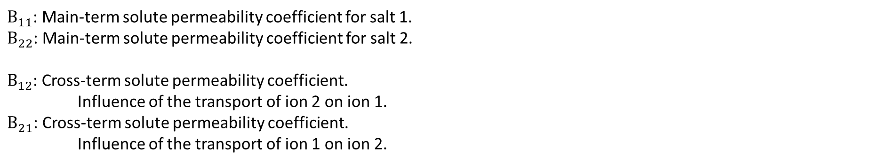
Nomenclature
$B_{11}$: Main-term solute permeability coefficient for salt 1.
$B_{22}$: Main-term solute permeability coefficient for salt 2.
$B_{12}$: Cross-term solute permeability coefficient.
Influence of the transport of ion 2 on ion 1.
$B_{21}$: Cross-term solute permeability coefficient.
Influence of the transport of ion 1 on ion 2.

Slide 4
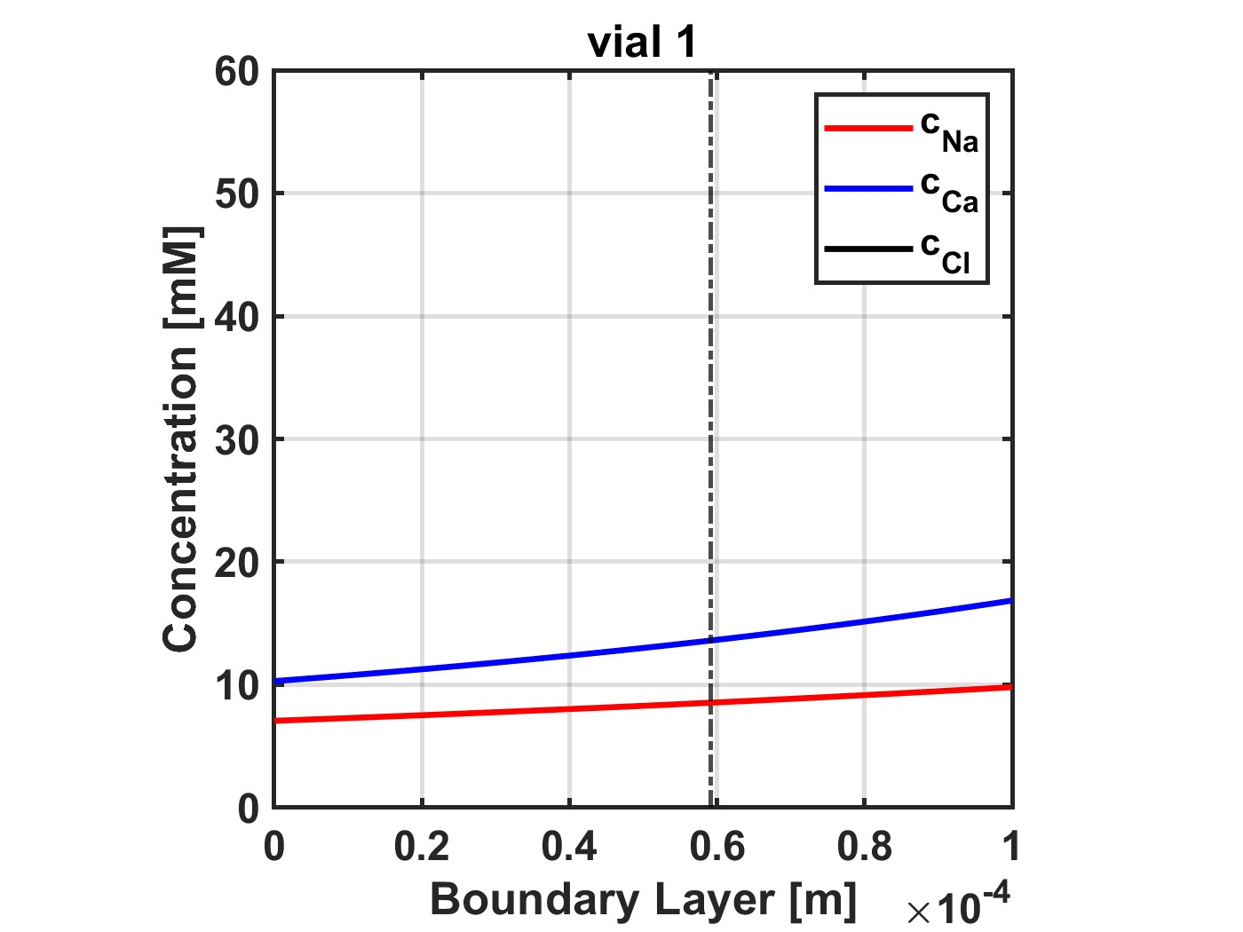
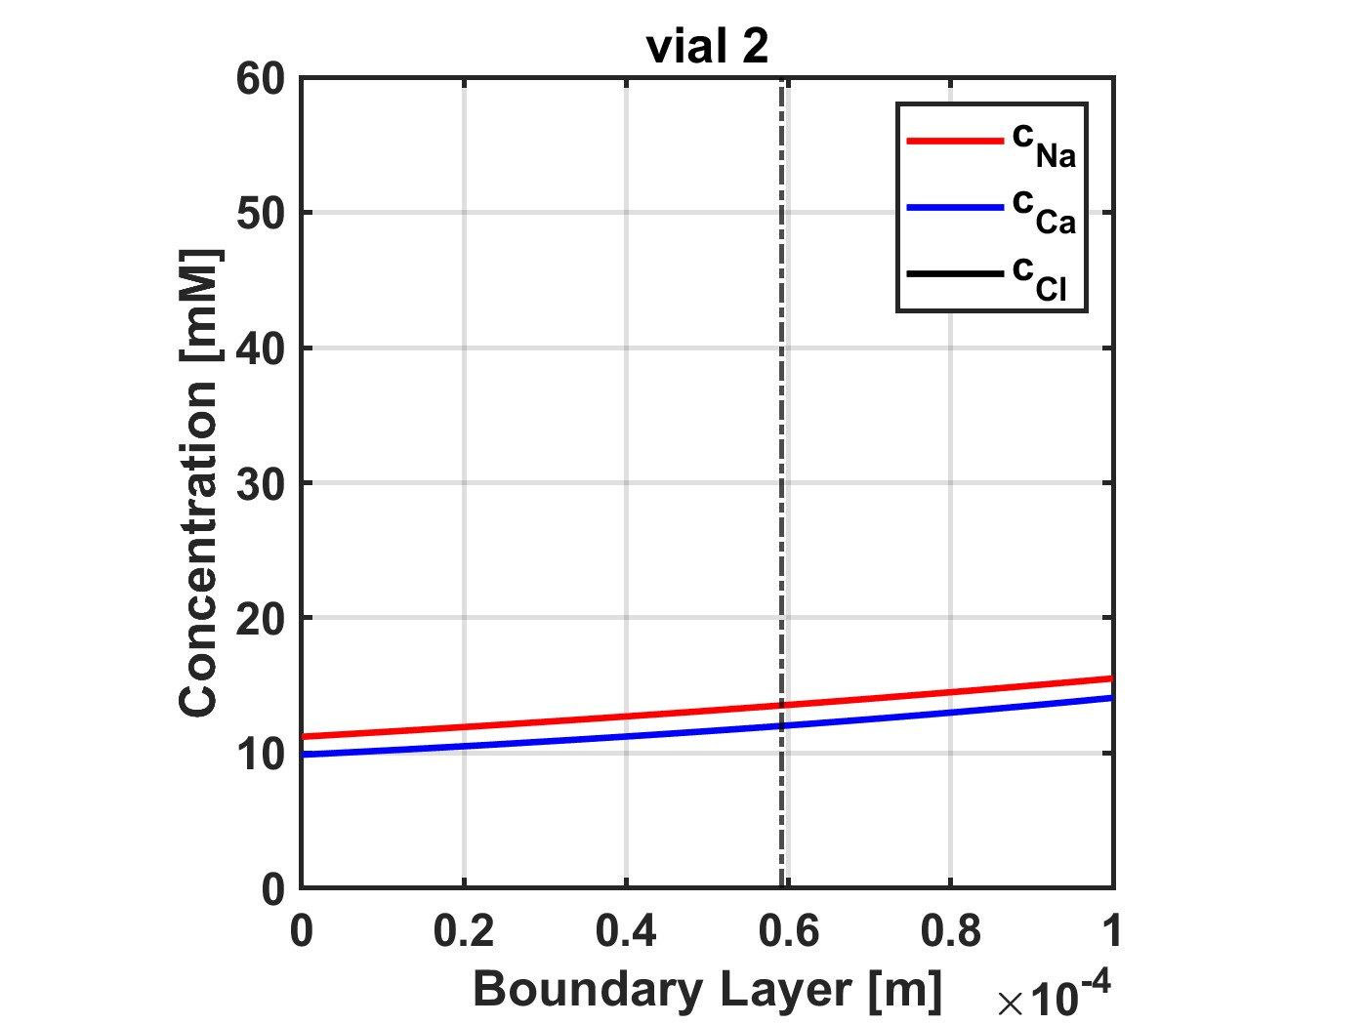
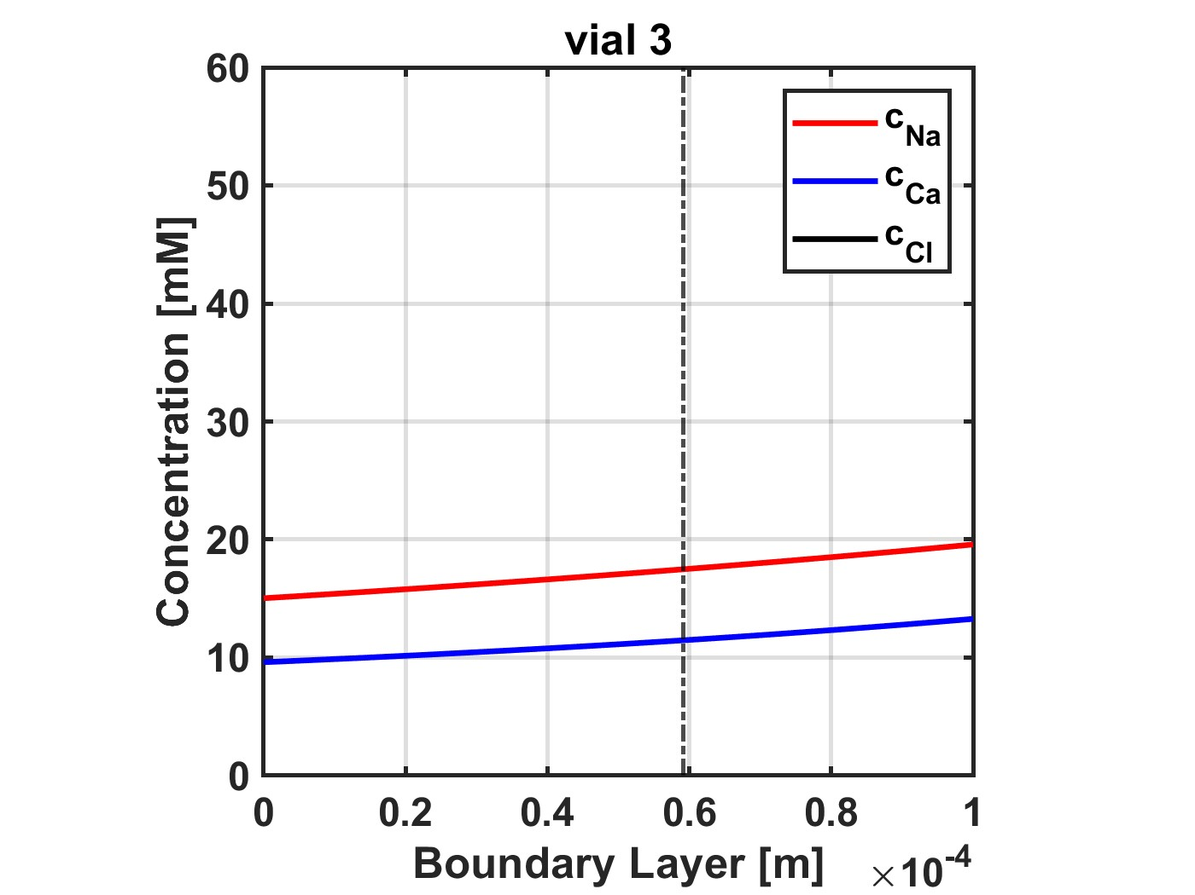
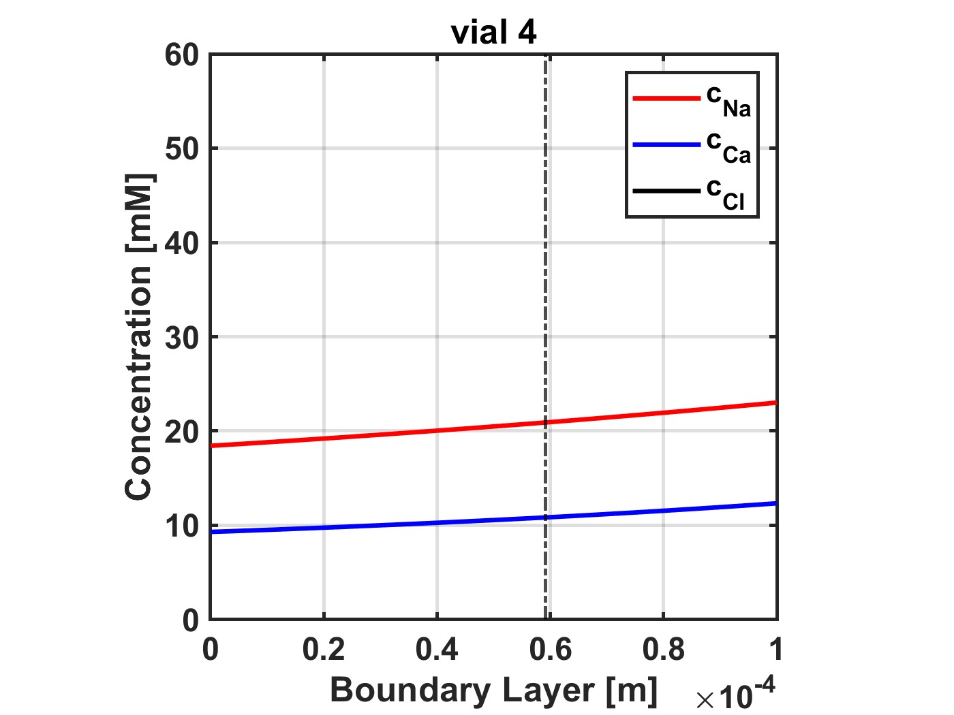
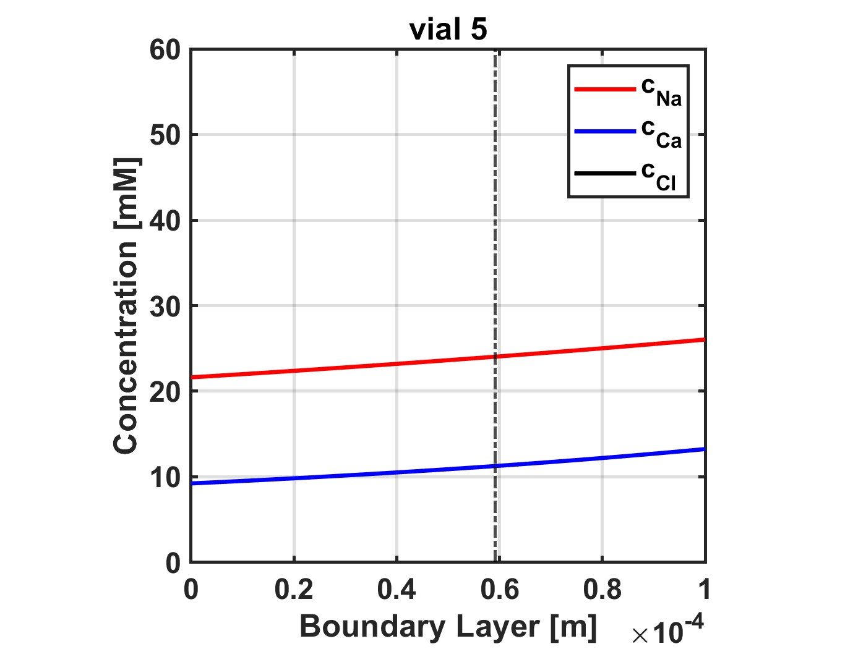

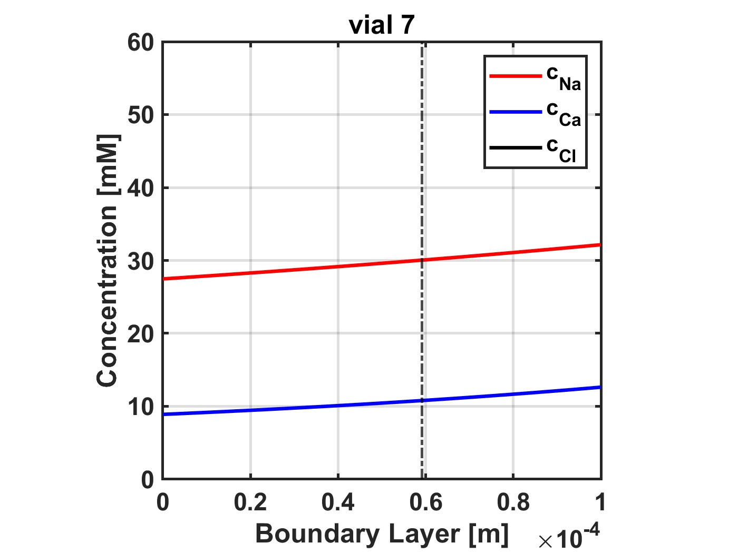
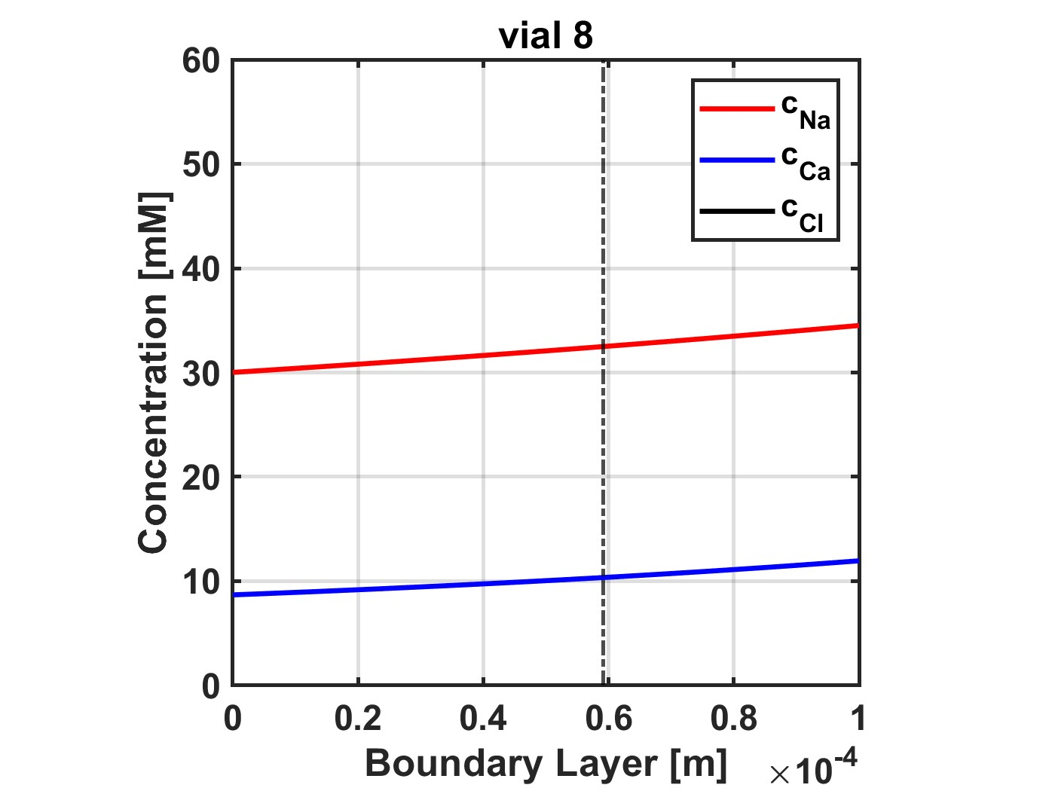
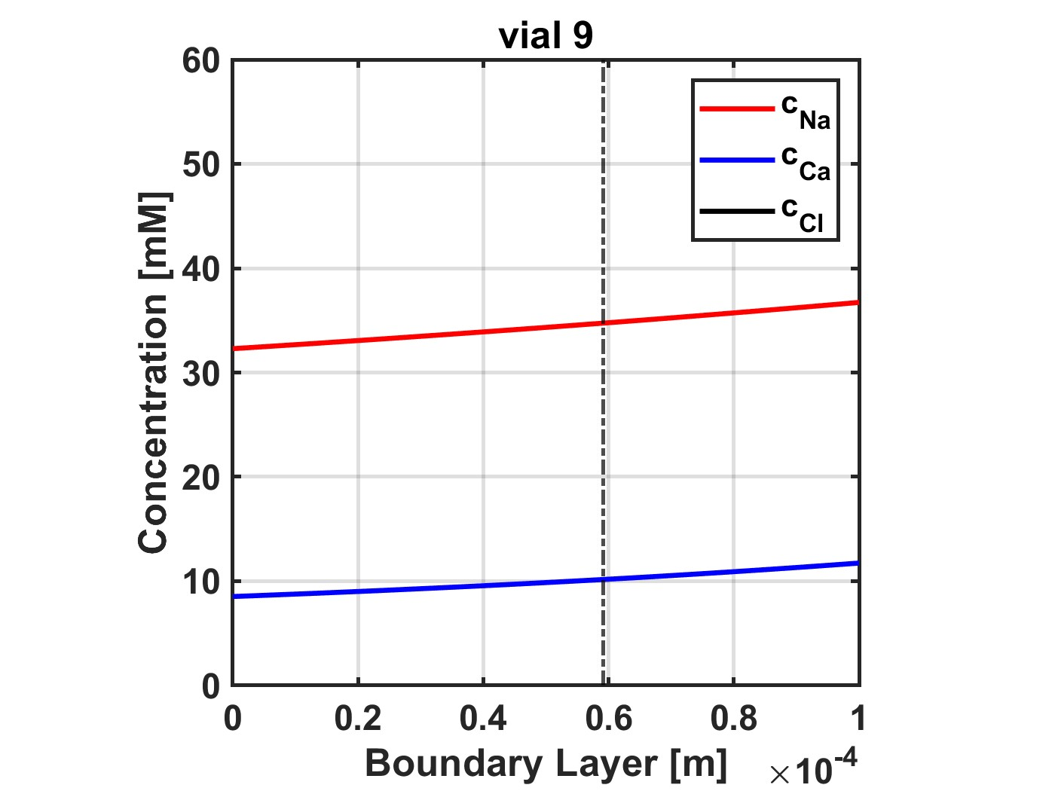

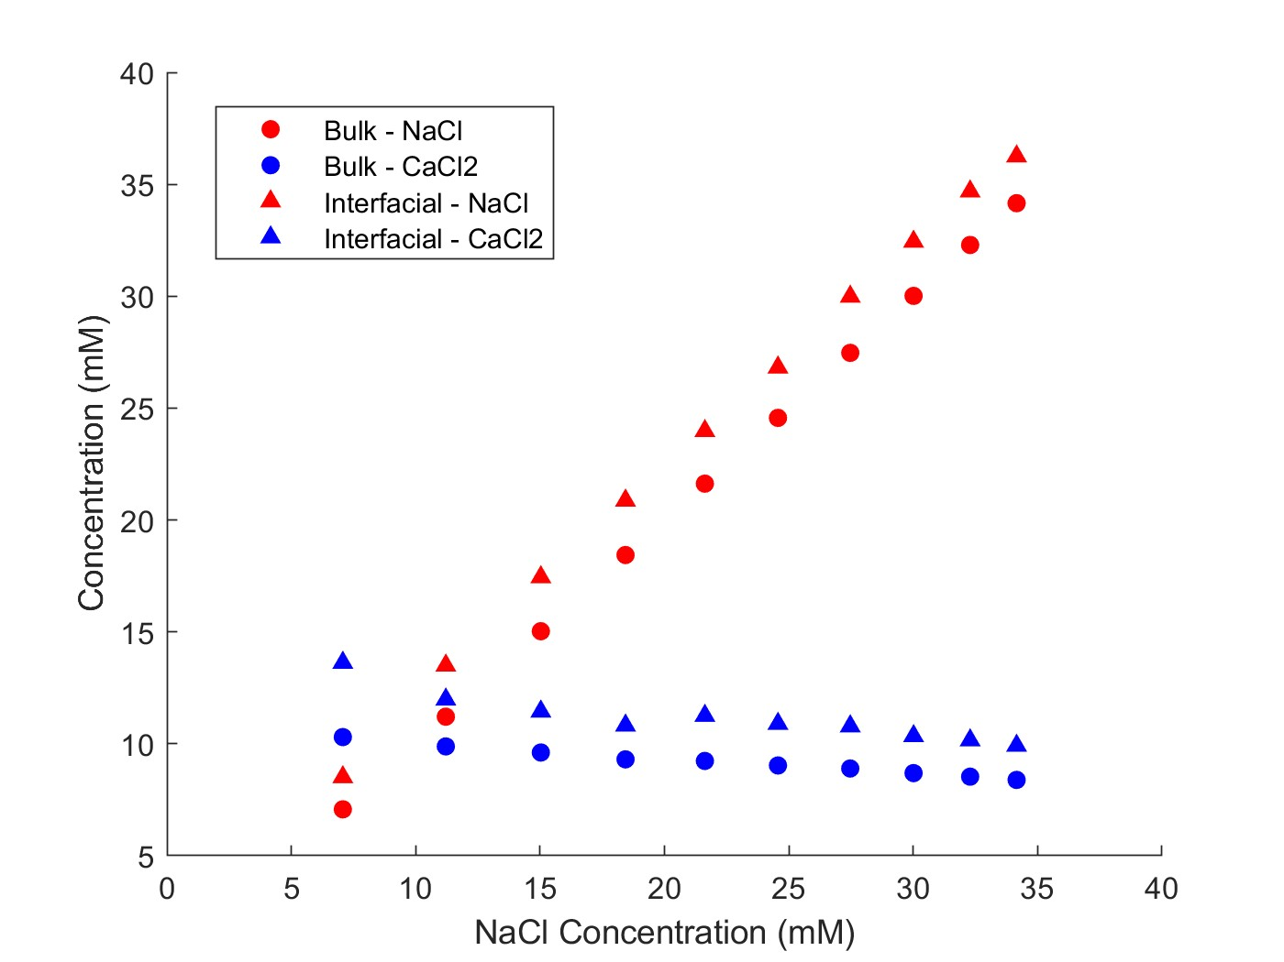
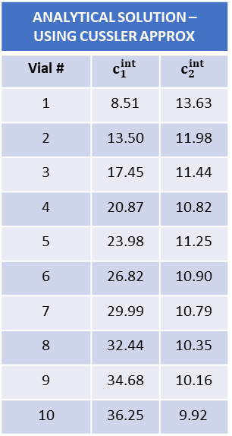
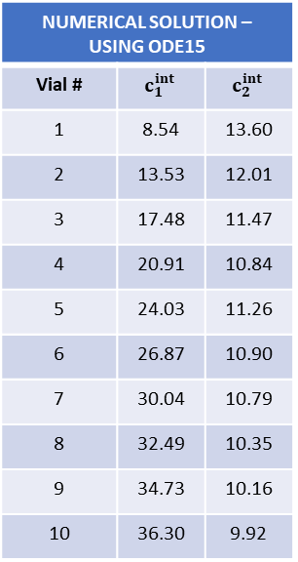
Multicomponent: NaCl, CaCl2
Feed: 10 mM CaCl2
Diafiltrate: 4 mM CaCl2; 50 mM NaCl
NF270_MC2, 05.08.24_E1
NUMERICAL SOLUTION – USING ODE15
Vial # | $$c_{1}^{int}$$ | $$c_{2}^{int}$$
1 | 8.54 | 13.60
2 | 13.53 | 12.01
3 | 17.48 | 11.47
4 | 20.91 | 10.84
5 | 24.03 | 11.26
6 | 26.87 | 10.90
7 | 30.04 | 10.79
8 | 32.49 | 10.35
9 | 34.73 | 10.16
10 | 36.30 | 9.92
ANALYTICAL SOLUTION – USING CUSSLER APPROX
Vial # | $$c_{1}^{int}$$ | $$c_{2}^{int}$$
1 | 8.51 | 13.63
2 | 13.50 | 11.98
3 | 17.45 | 11.44
4 | 20.87 | 10.82
5 | 23.98 | 11.25
6 | 26.82 | 10.90
7 | 29.99 | 10.79
8 | 32.44 | 10.35
9 | 34.68 | 10.16
10 | 36.25 | 9.92

Slide 5
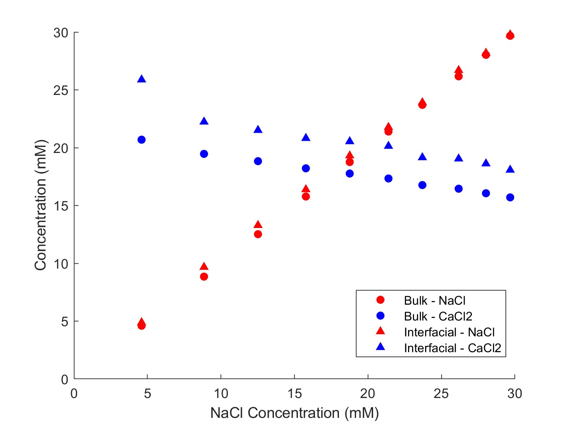
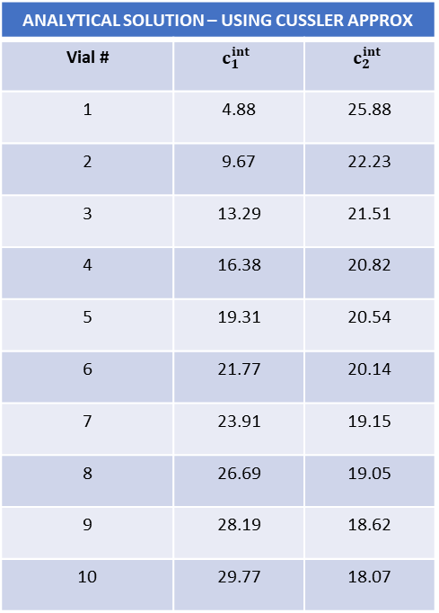
NF270_MC2, 05.08.24_E2
Multicomponent: NaCl, CaCl2
Feed: 20 mM CaCl2
Diafiltrate: 8 mM CaCl2; 50 mM NaCl
ANALYTICAL SOLUTION – USING CUSSLER APPROX
Vial # | $$c_{1}^{int}$$ | $$c_{2}^{int}$$
1 | 4.88 | 25.88
2 | 9.67 | 22.23
3 | 13.29 | 21.51
4 | 16.38 | 20.82
5 | 19.31 | 20.54
6 | 21.77 | 20.14
7 | 23.91 | 19.15
8 | 26.69 | 19.05
9 | 28.19 | 18.62
10 | 29.77 | 18.07

Slide 6
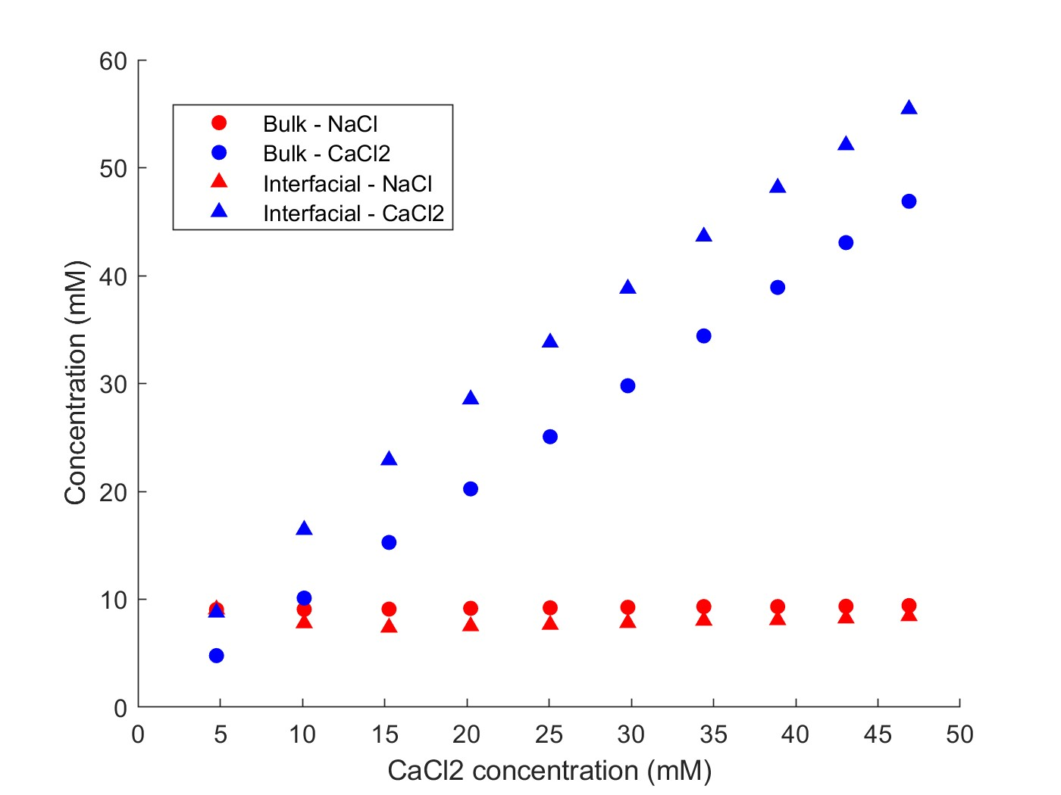
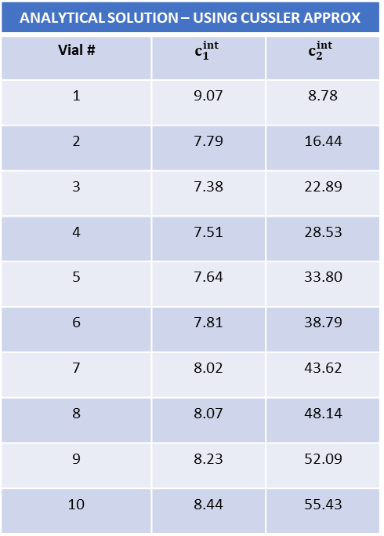
Multicomponent: NaCl, CaCl2
Feed: 10 mM NaCl
Diafiltrate: 5 mM NaCl; 50 mM CaCl2
NF270_MC5, 06.05.26_E3
ANALYTICAL SOLUTION – USING CUSSLER APPROX
Vial # | $$c_{1}^{int}$$ | $$c_{2}^{int}$$
1 | 9.07 | 8.78
2 | 7.79 | 16.44
3 | 7.38 | 22.89
4 | 7.51 | 28.53
5 | 7.64 | 33.80
6 | 7.81 | 38.79
7 | 8.02 | 43.62
8 | 8.07 | 48.14
9 | 8.23 | 52.09
10 | 8.44 | 55.43

Slide 7
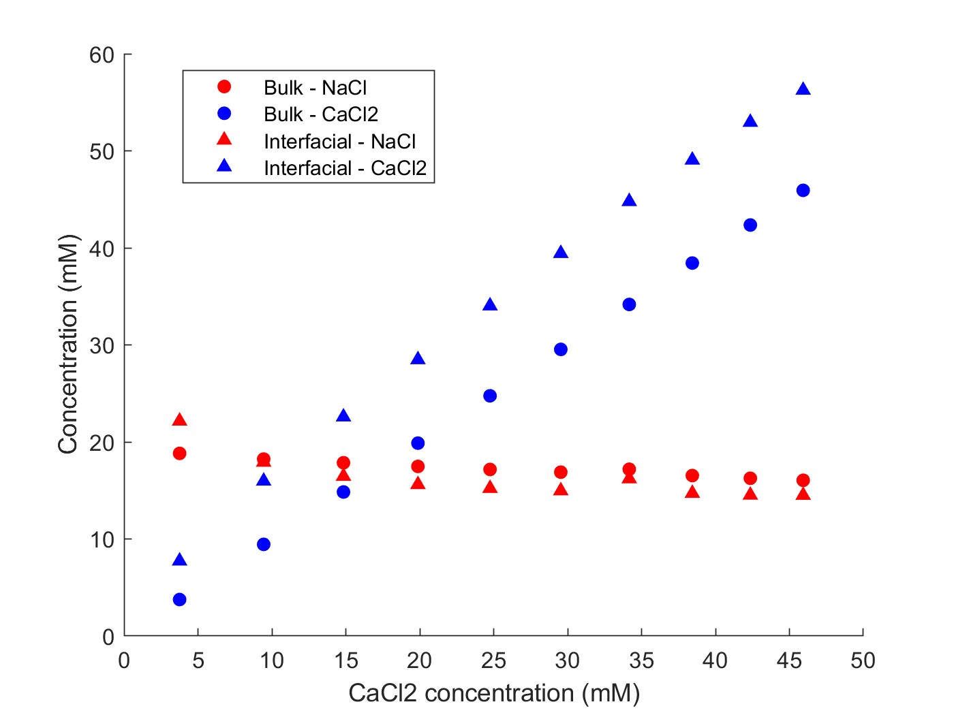
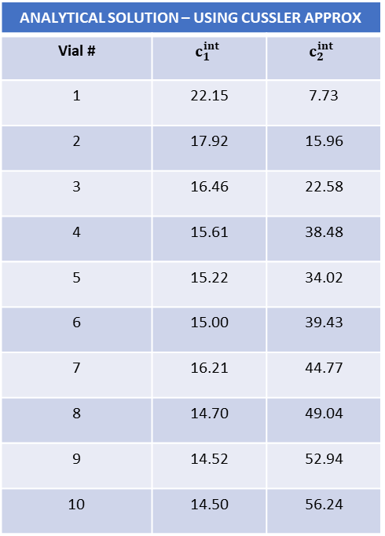
Multicomponent: NaCl, CaCl2
Feed: 20 mM NaCl
Diafiltrate: 10 mM NaCl; 50 mM CaCl2
NF270_MC5, 06.05.26_E4
ANALYTICAL SOLUTION – USING CUSSLER APPROX
Vial # | $$c_{1}^{int}$$ | $$c_{2}^{int}$$
1 | 22.15 | 7.73
2 | 17.92 | 15.96
3 | 16.46 | 22.58
4 | 15.61 | 38.48
5 | 15.22 | 34.02
6 | 15.00 | 39.43
7 | 16.21 | 44.77
8 | 14.70 | 49.04
9 | 14.52 | 52.94
10 | 14.50 | 56.24

Slide 8
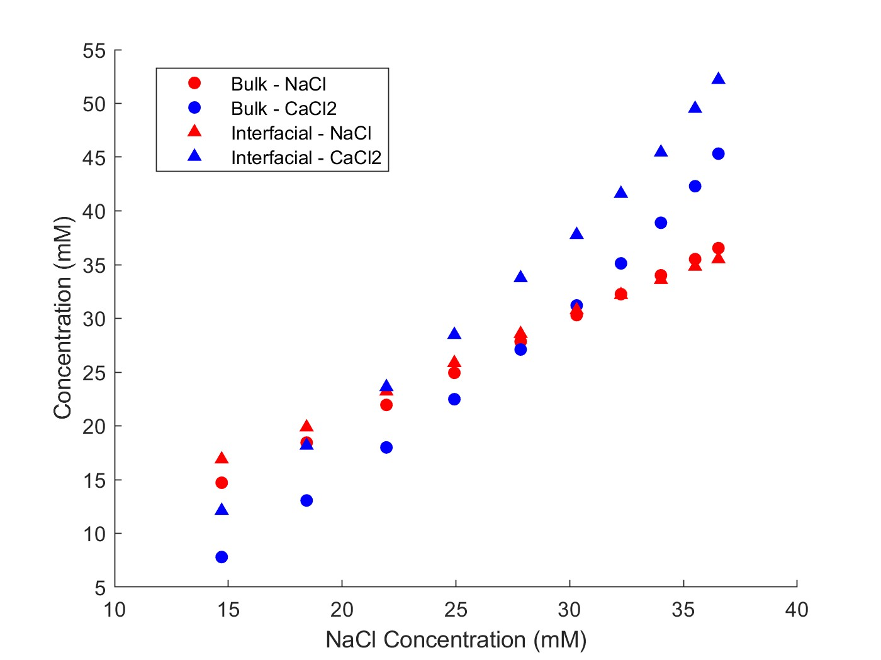
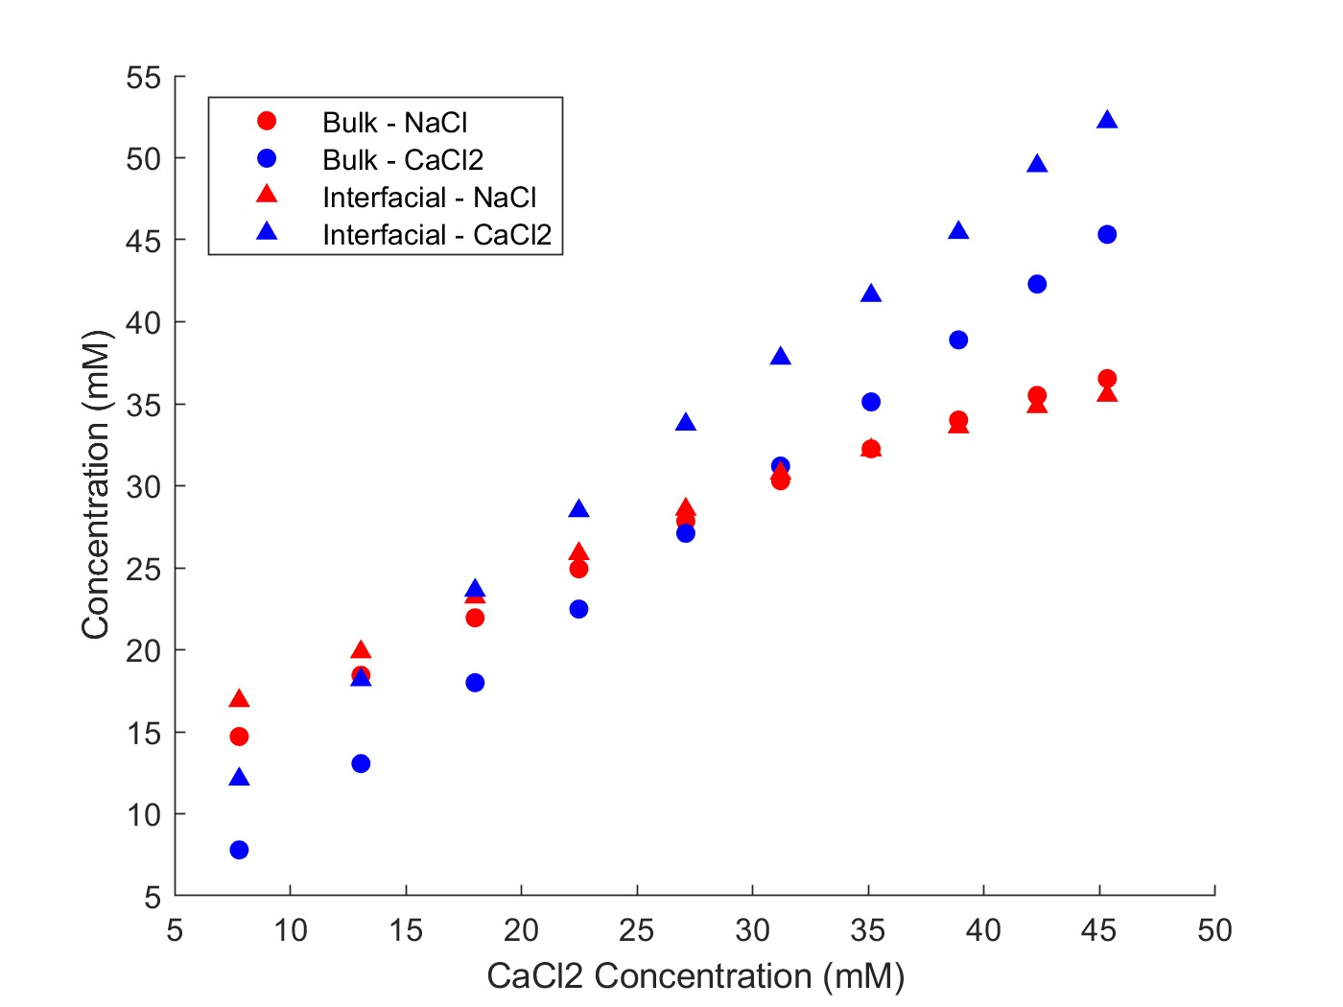
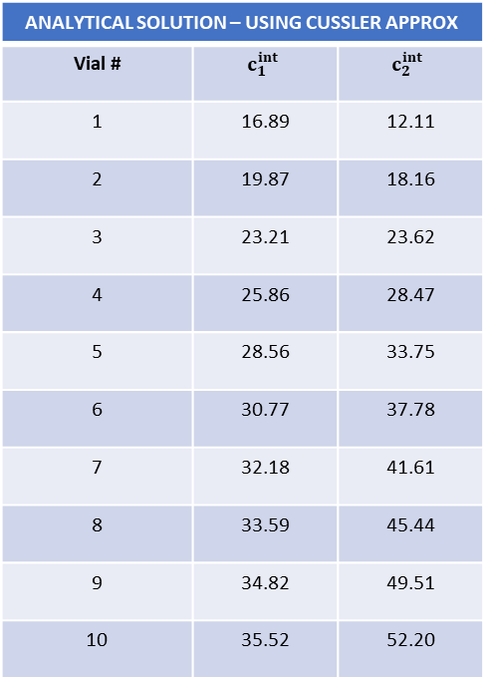
Multicomponent: NaCl, CaCl2
Feed: 10 mM NaCl; 1 mM CaCl2
Diafiltrate: 50 mM NaCl; 50 mM CaCl2
NF270_MC2, 05.09.24_E5
ANALYTICAL SOLUTION – USING CUSSLER APPROX
Vial # | $$c_{1}^{int}$$ | $$c_{2}^{int}$$
1 | 16.89 | 12.11
2 | 19.87 | 18.16
3 | 23.21 | 23.62
4 | 25.86 | 28.47
5 | 28.56 | 33.75
6 | 30.77 | 37.78
7 | 32.18 | 41.61
8 | 33.59 | 45.44
9 | 34.82 | 49.51
10 | 35.52 | 52.20

Slide 9
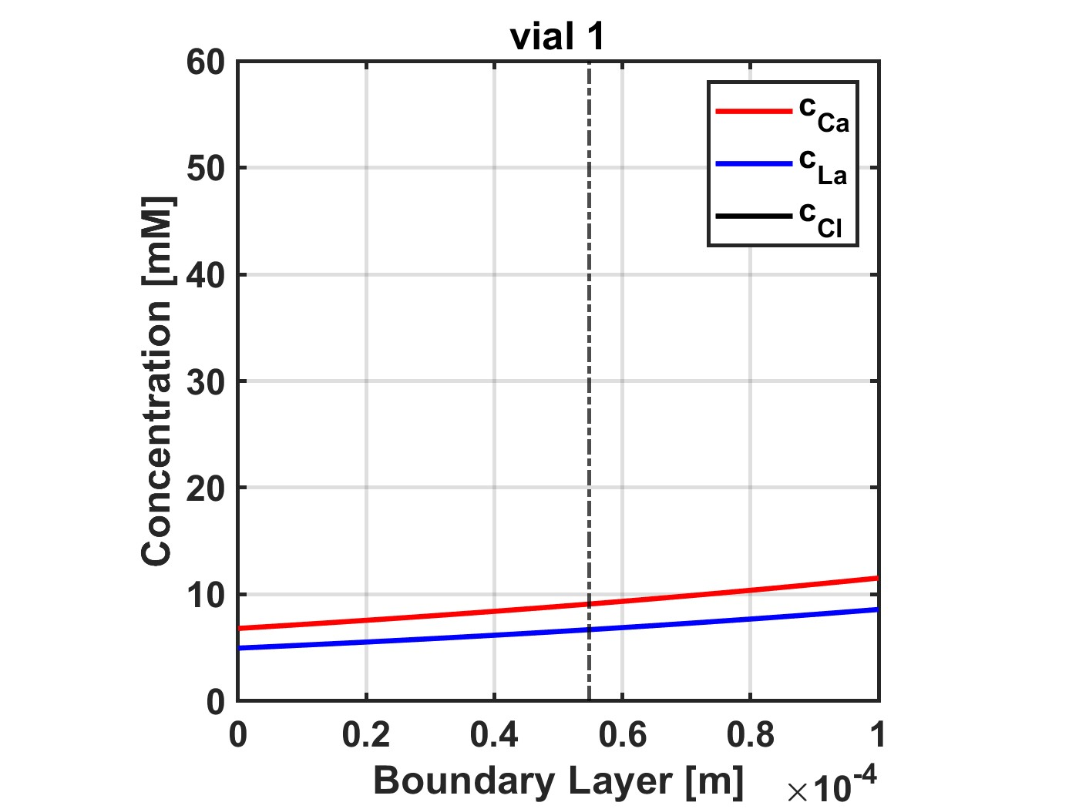
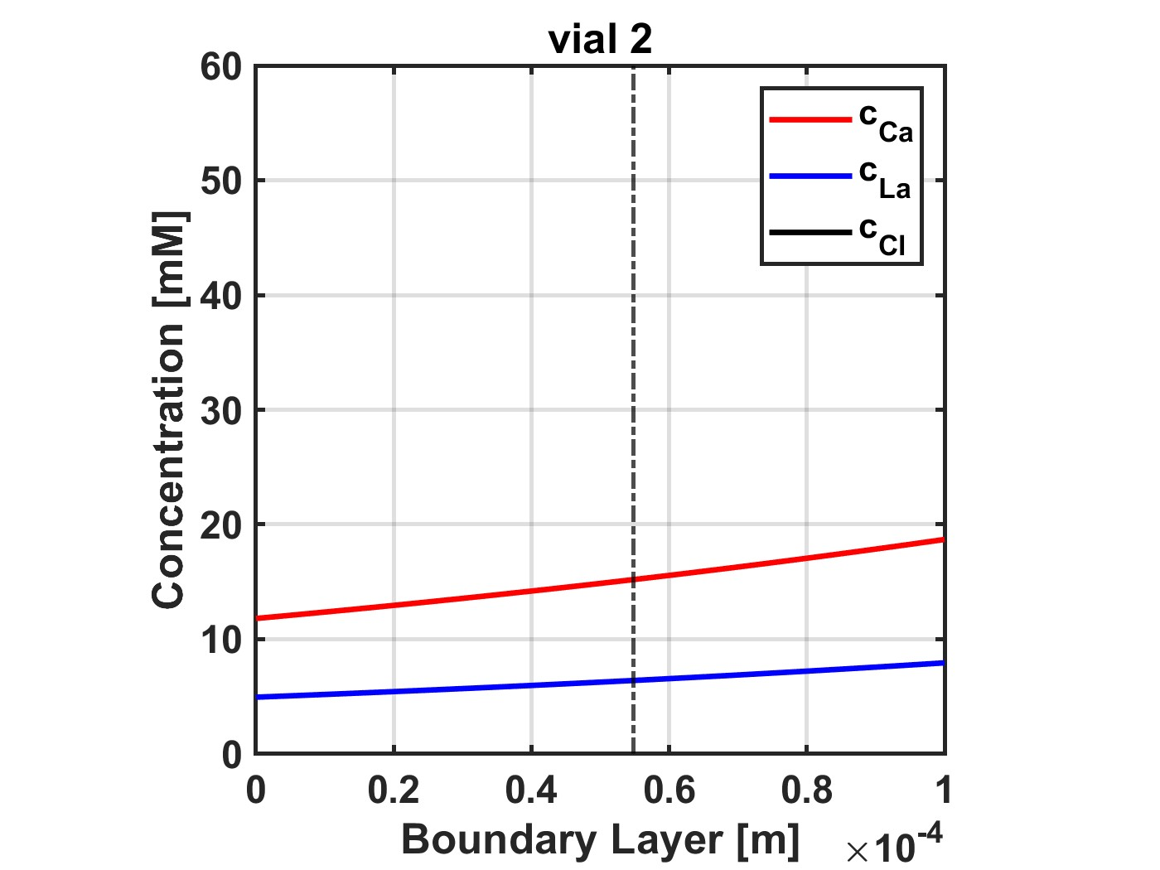
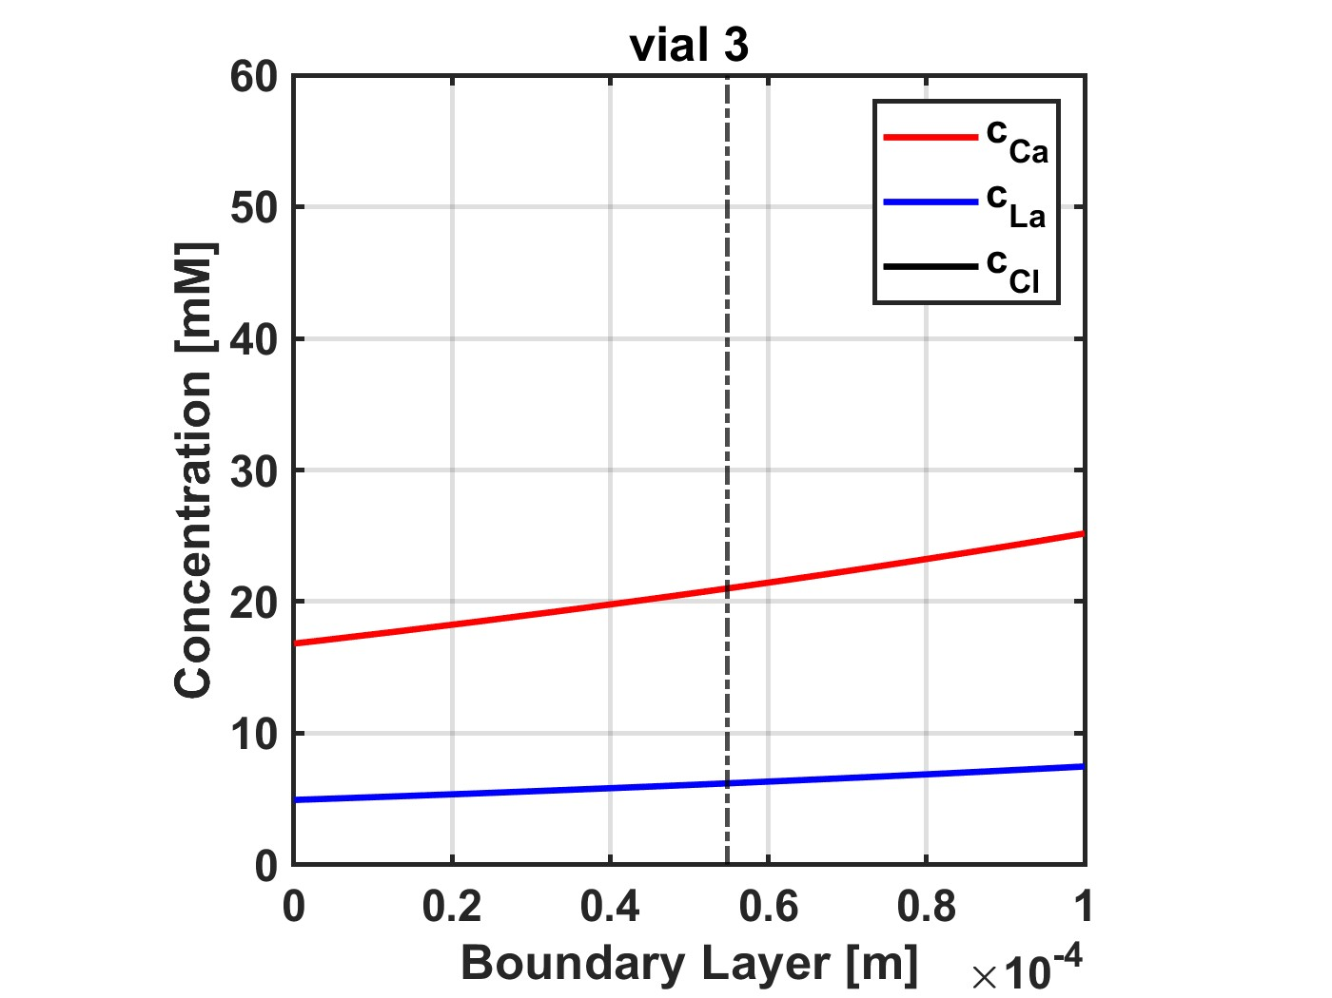
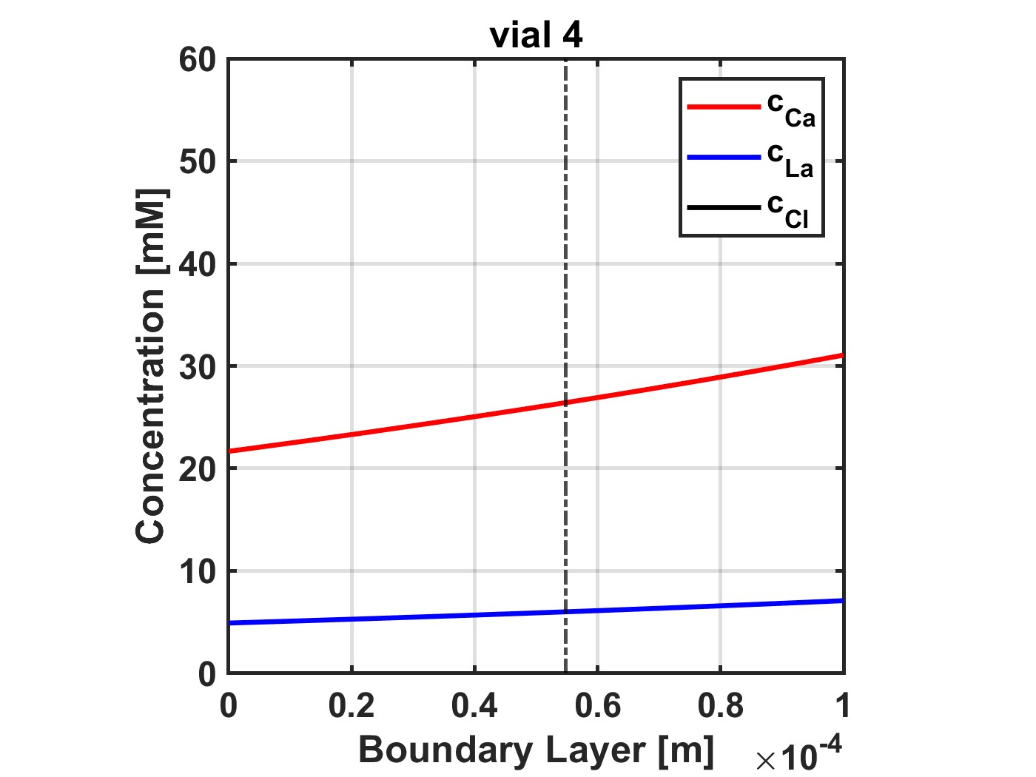
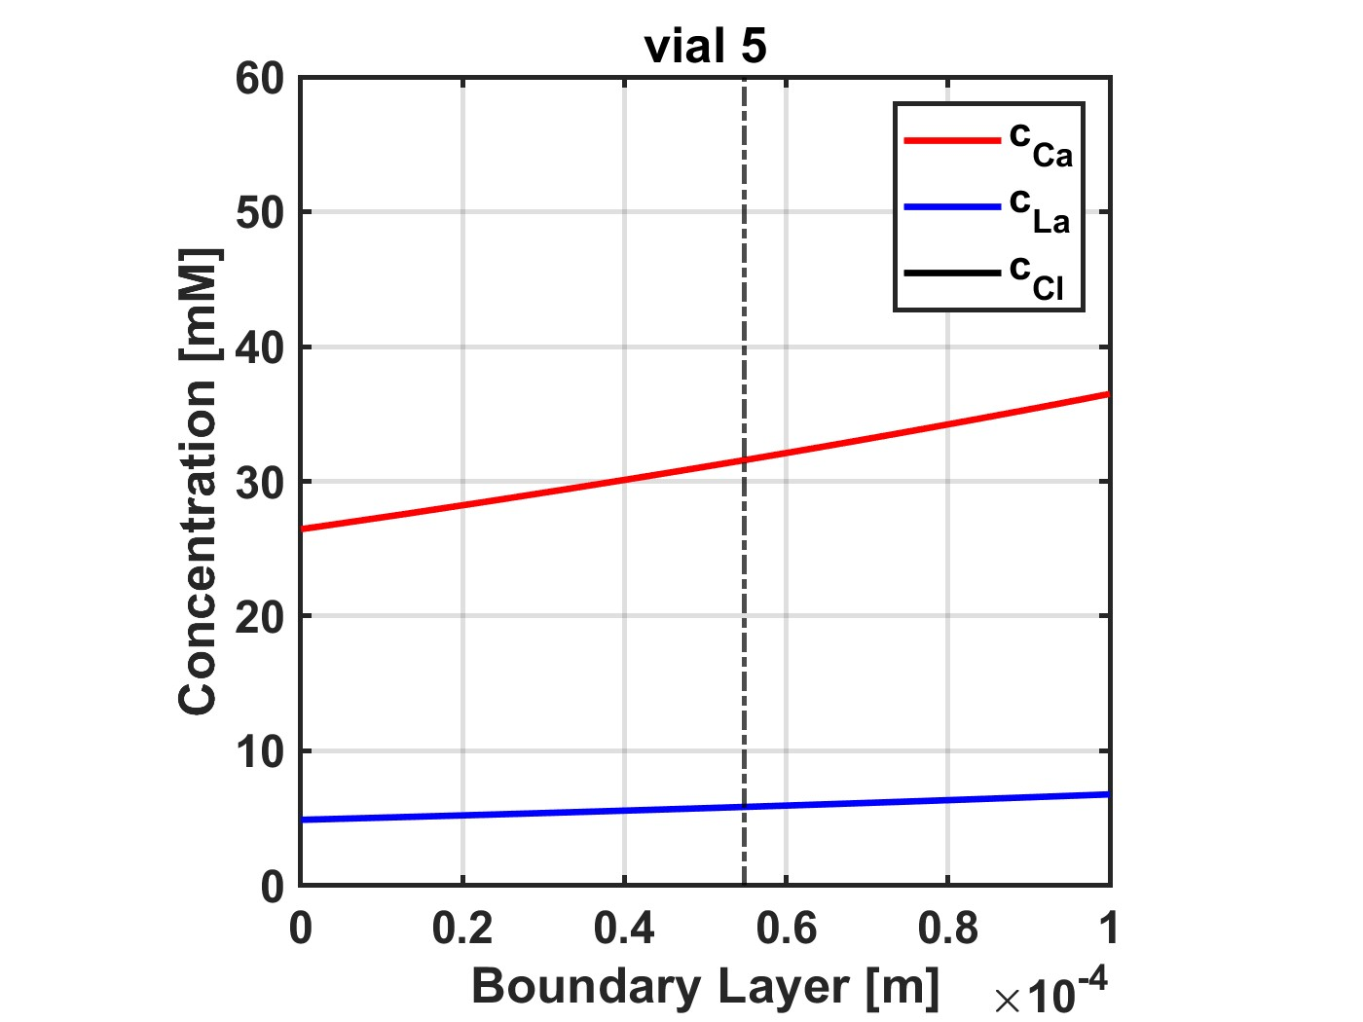
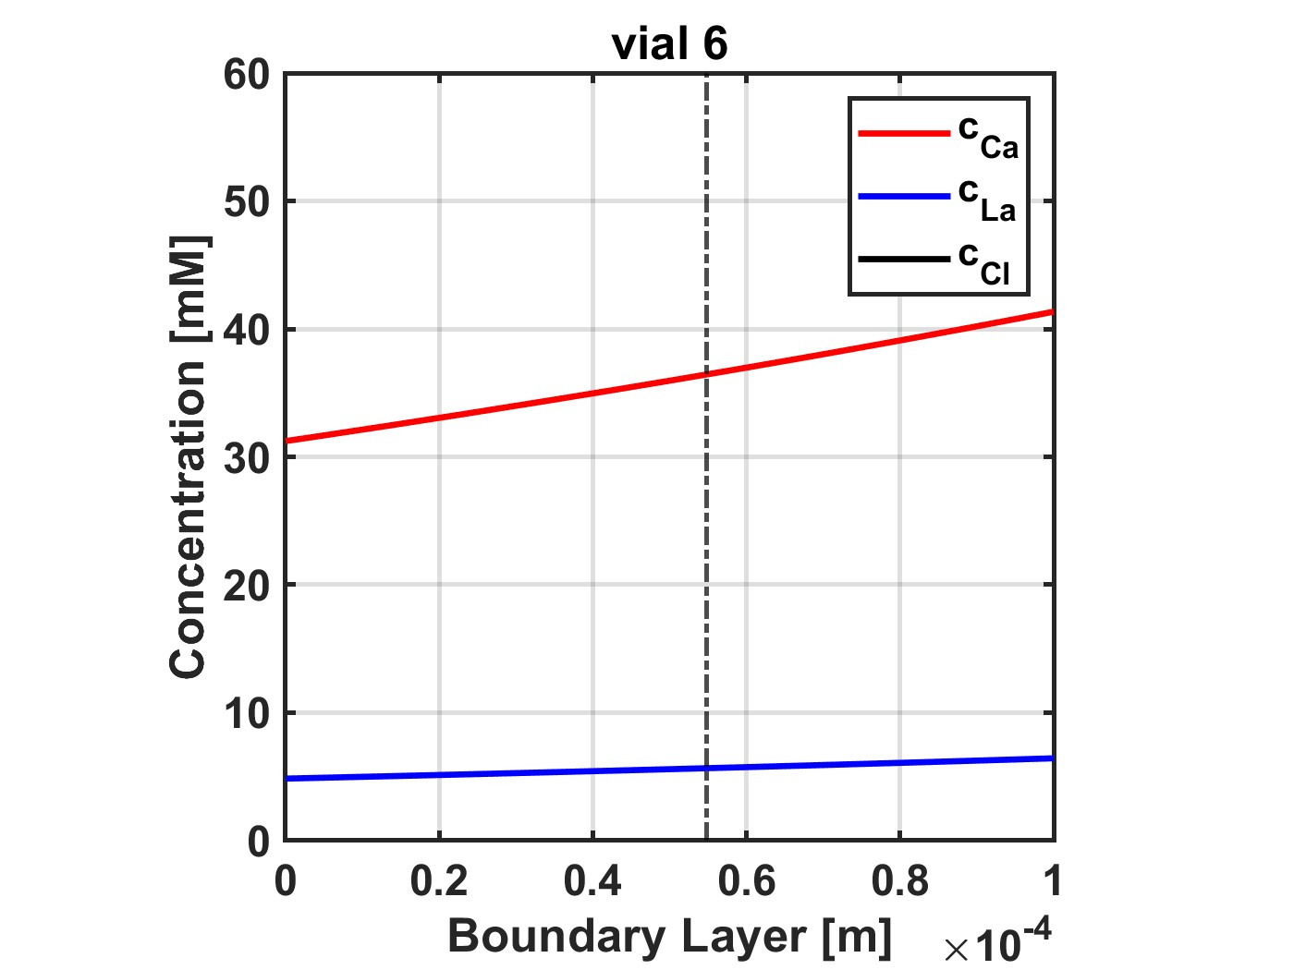
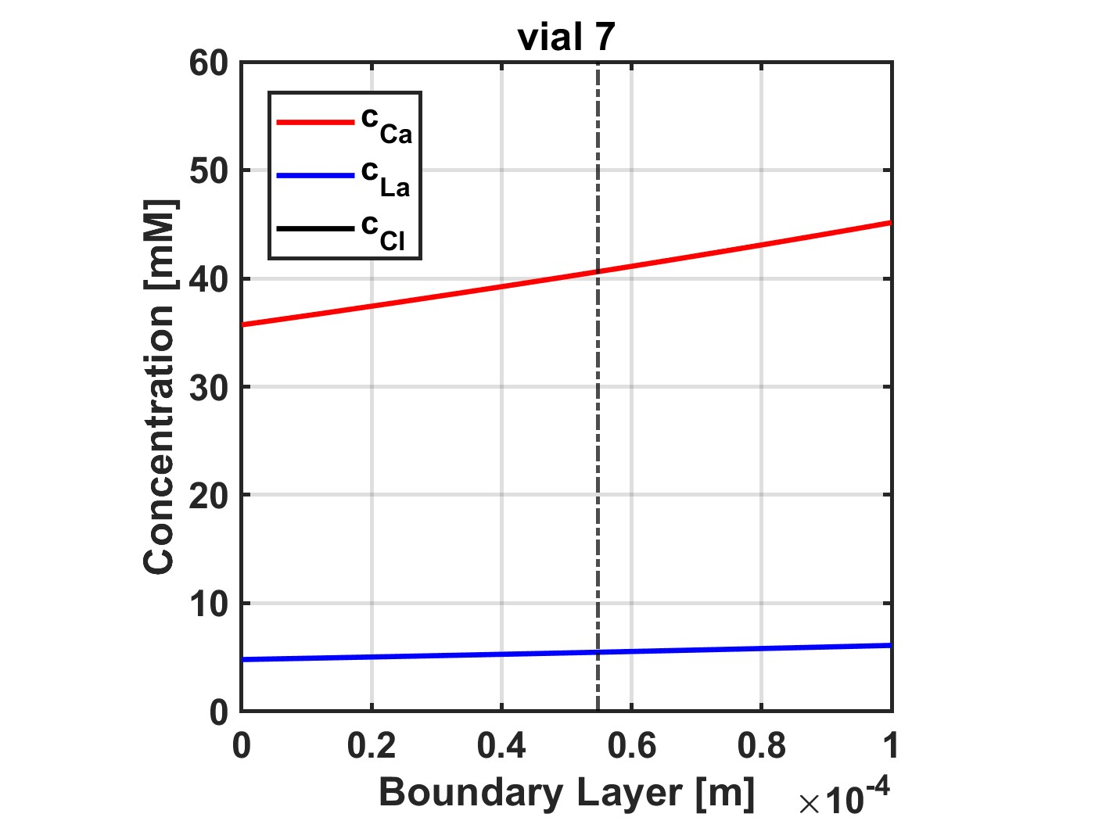
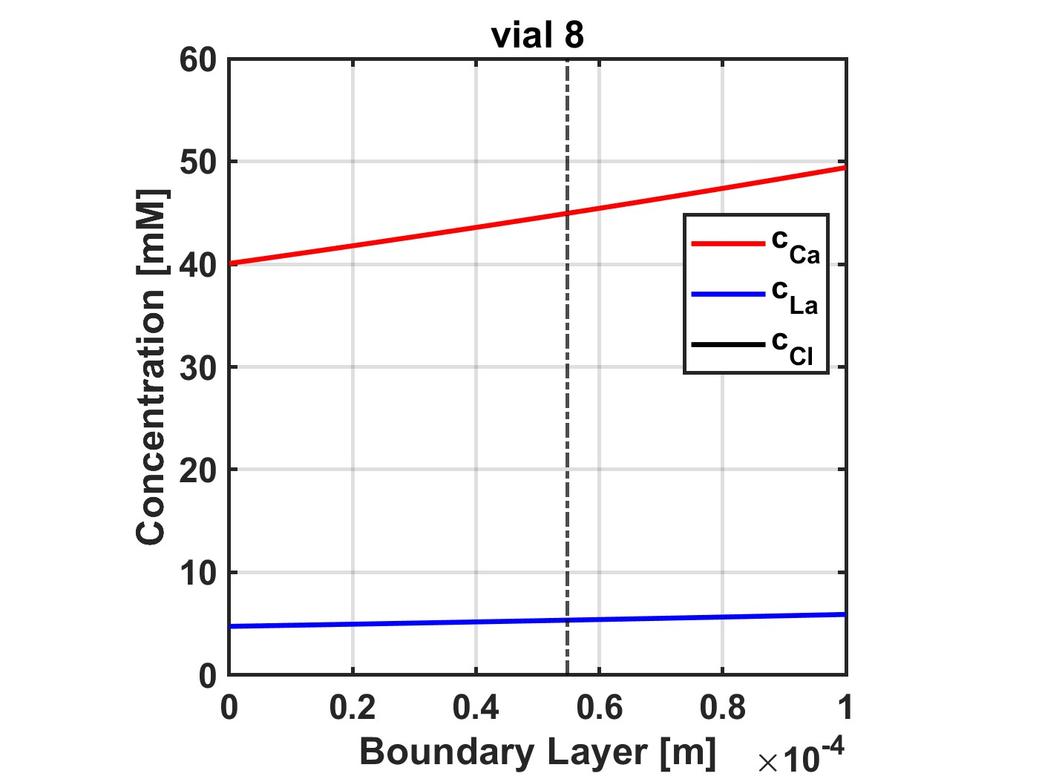
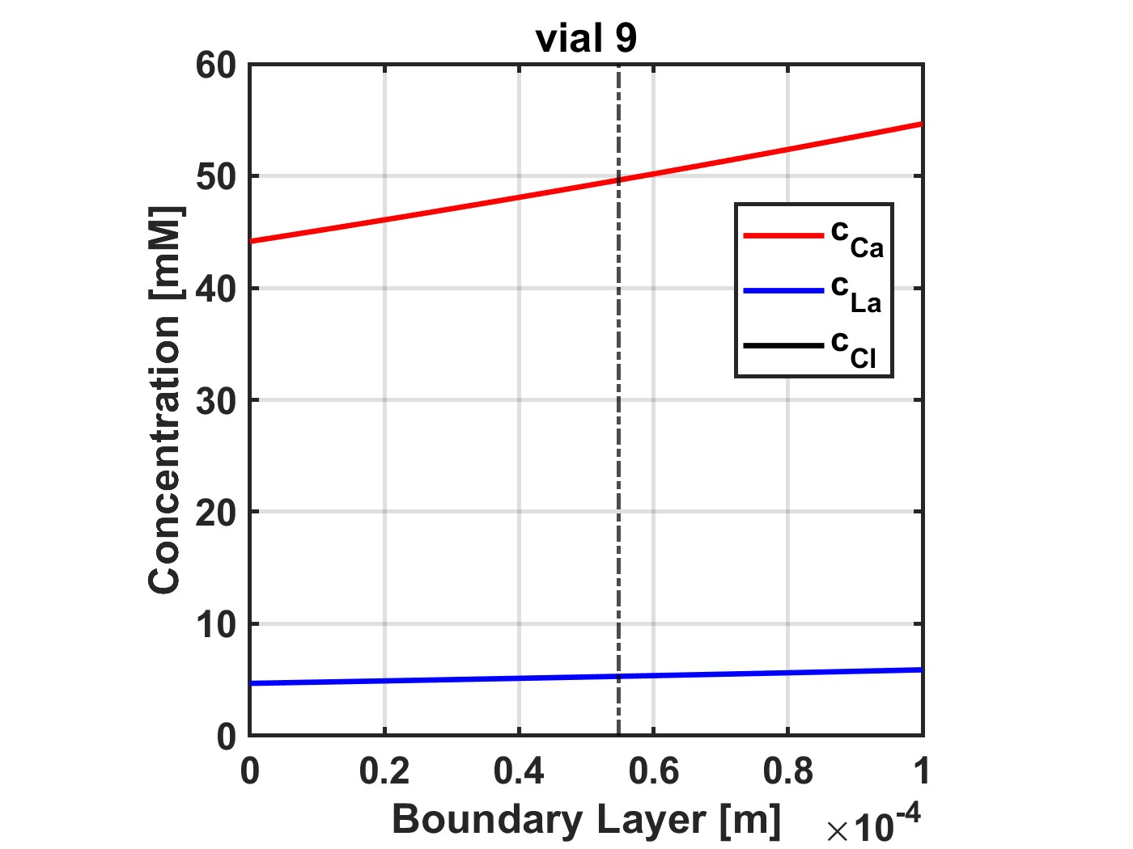
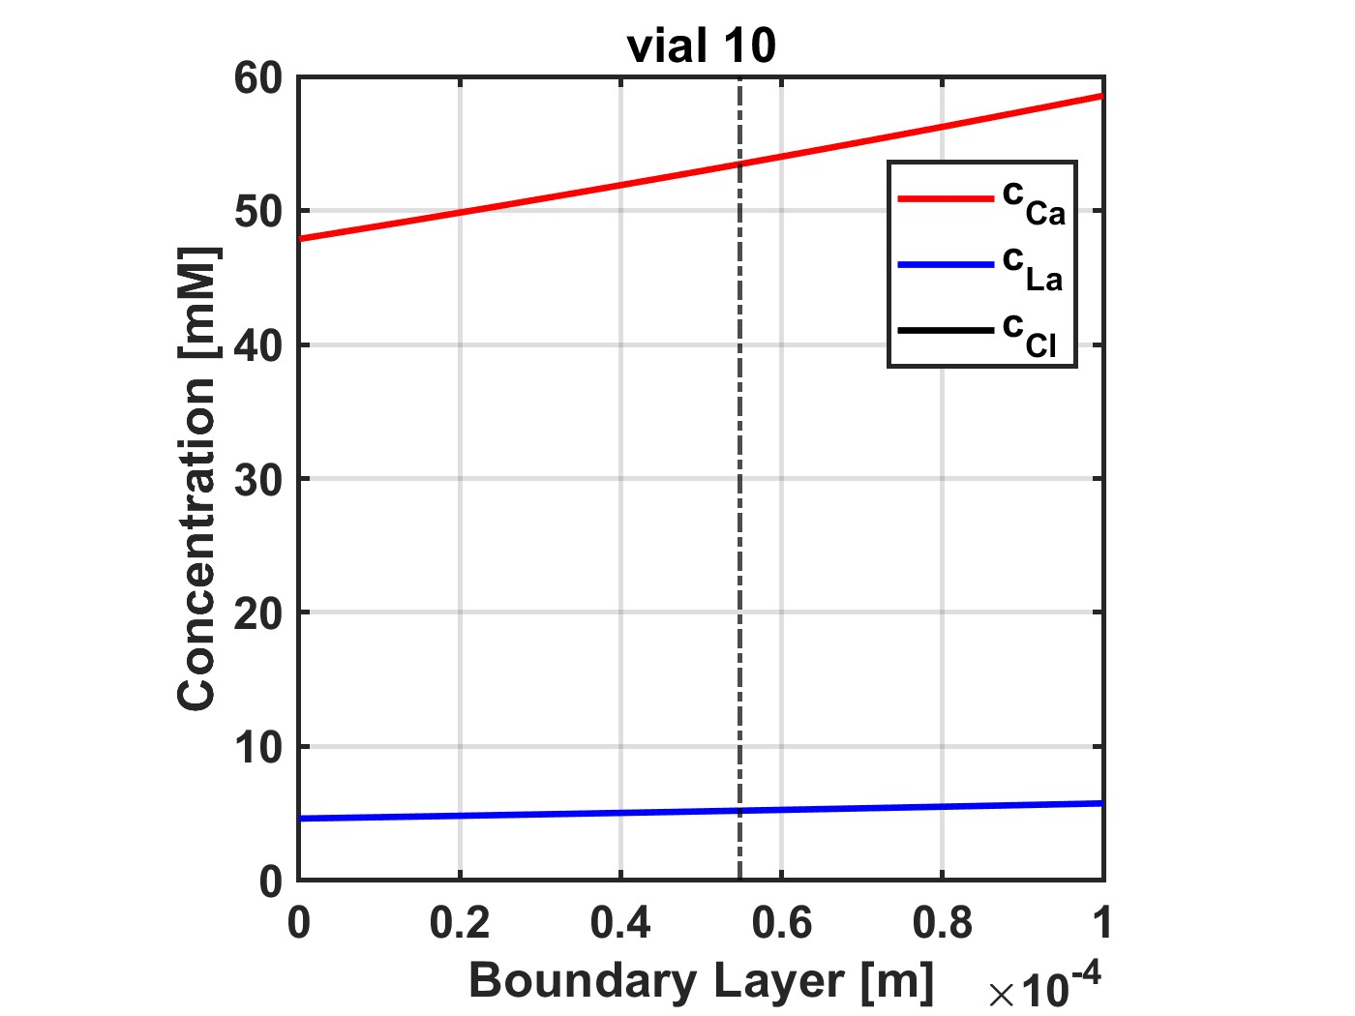
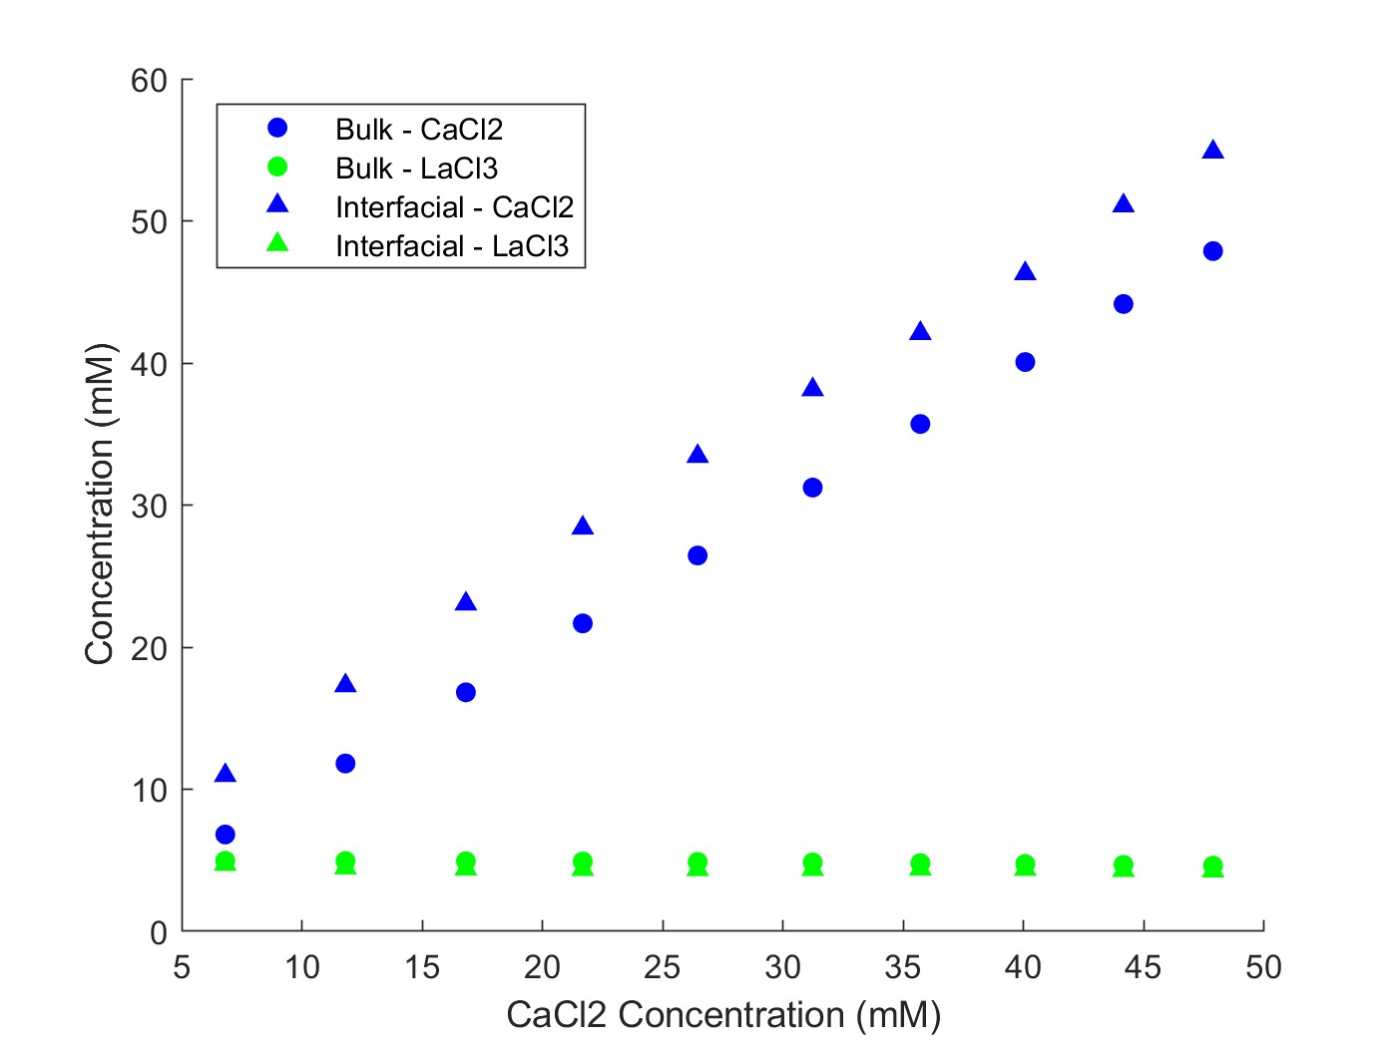
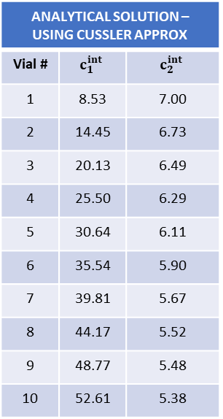
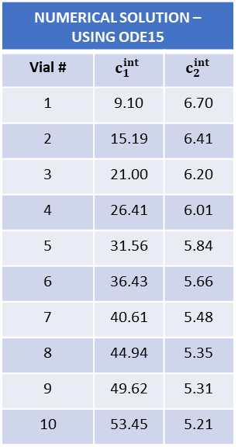
Multicomponent: CaCl2, LaCl3
Feed: 5 mM LaCl3
Diafiltrate: 0.4 mM LaCl3; 50 mM CaCl2
NF270_MC2, 05.21.24_E6
NUMERICAL SOLUTION – USING ODE15
Vial # | $$c_{1}^{int}$$ | $$c_{2}^{int}$$
1 | 9.10 | 6.70
2 | 15.19 | 6.41
3 | 21.00 | 6.20
4 | 26.41 | 6.01
5 | 31.56 | 5.84
6 | 36.43 | 5.66
7 | 40.61 | 5.48
8 | 44.94 | 5.35
9 | 49.62 | 5.31
10 | 53.45 | 5.21
ANALYTICAL SOLUTION – USING CUSSLER APPROX
Vial # | $$c_{1}^{int}$$ | $$c_{2}^{int}$$
1 | 8.53 | 7.00
2 | 14.45 | 6.73
3 | 20.13 | 6.49
4 | 25.50 | 6.29
5 | 30.64 | 6.11
6 | 35.54 | 5.90
7 | 39.81 | 5.67
8 | 44.17 | 5.52
9 | 48.77 | 5.48
10 | 52.61 | 5.38

Slide 10
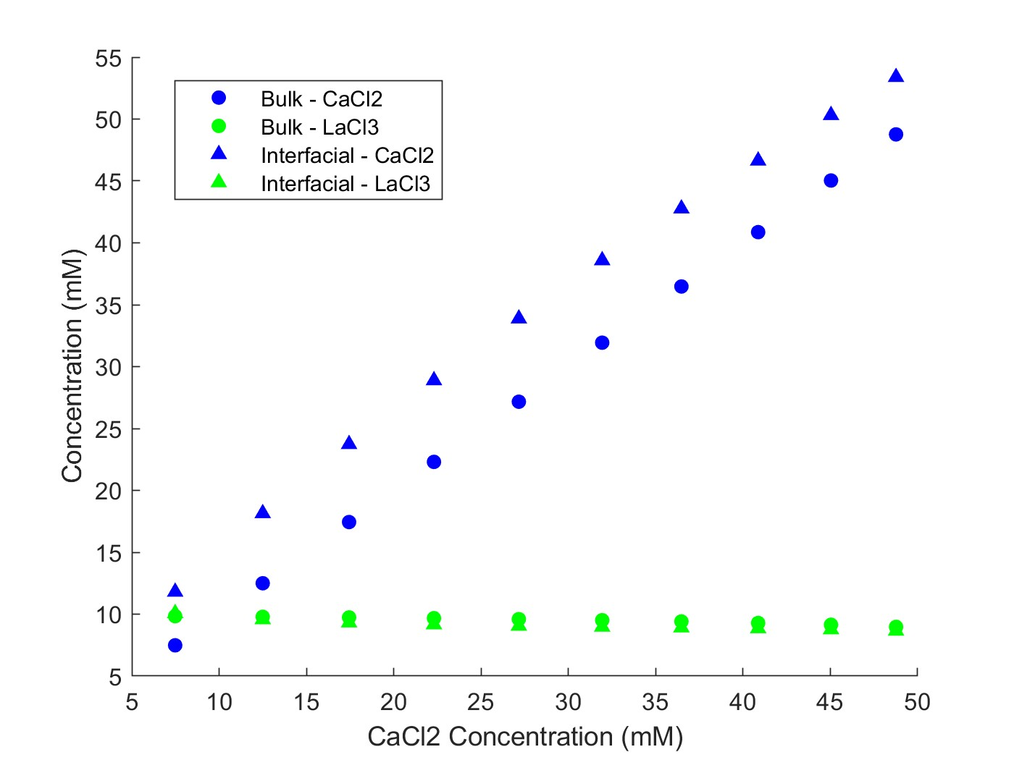
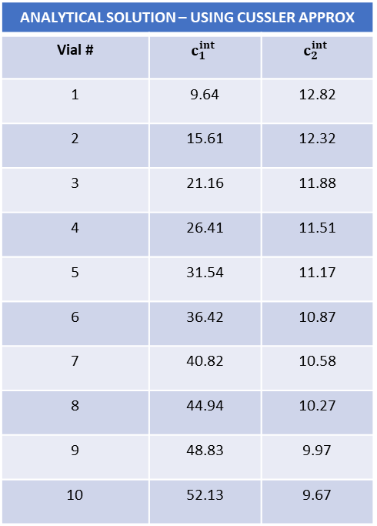
Multicomponent: CaCl2, LaCl3
Feed: 10 mM LaCl3
Diafiltrate: 0.4 mM LaCl3; 50 mM CaCl2
NF270_MC2, 05.21.24_E7
ANALYTICAL SOLUTION – USING CUSSLER APPROX
Vial # | $$c_{1}^{int}$$ | $$c_{2}^{int}$$
1 | 9.64 | 12.82
2 | 15.61 | 12.32
3 | 21.16 | 11.88
4 | 26.41 | 11.51
5 | 31.54 | 11.17
6 | 36.42 | 10.87
7 | 40.82 | 10.58
8 | 44.94 | 10.27
9 | 48.83 | 9.97
10 | 52.13 | 9.67

Slide 11
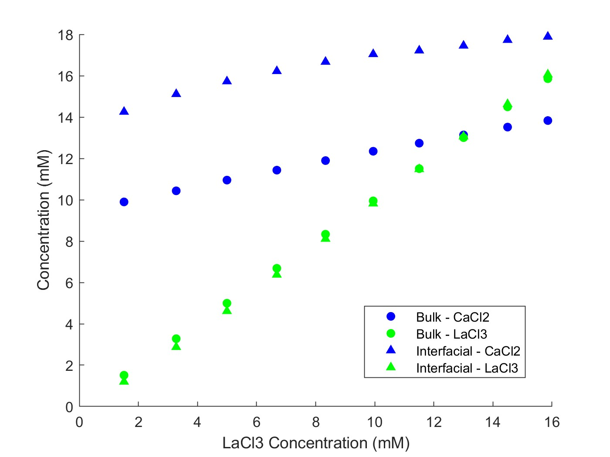
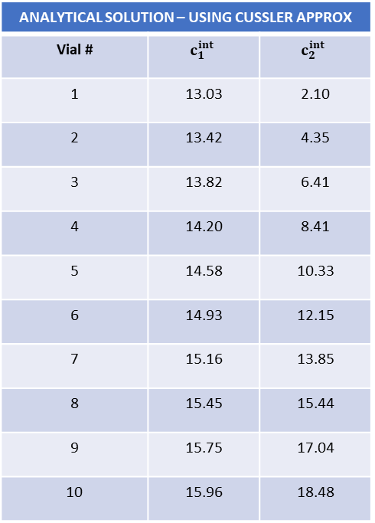
Multicomponent: CaCl2, LaCl3
Feed: 10 mM CaCl2
Diafiltrate: 6 mM CaCl2; 15 mM LaCl3
NF270_MC2, 05.22.24_E8
ANALYTICAL SOLUTION – USING CUSSLER APPROX
Vial # | $$c_{1}^{int}$$ | $$c_{2}^{int}$$
1 | 13.03 | 2.10
2 | 13.42 | 4.35
3 | 13.82 | 6.41
4 | 14.20 | 8.41
5 | 14.58 | 10.33
6 | 14.93 | 12.15
7 | 15.16 | 13.85
8 | 15.45 | 15.44
9 | 15.75 | 17.04
10 | 15.96 | 18.48

Slide 12
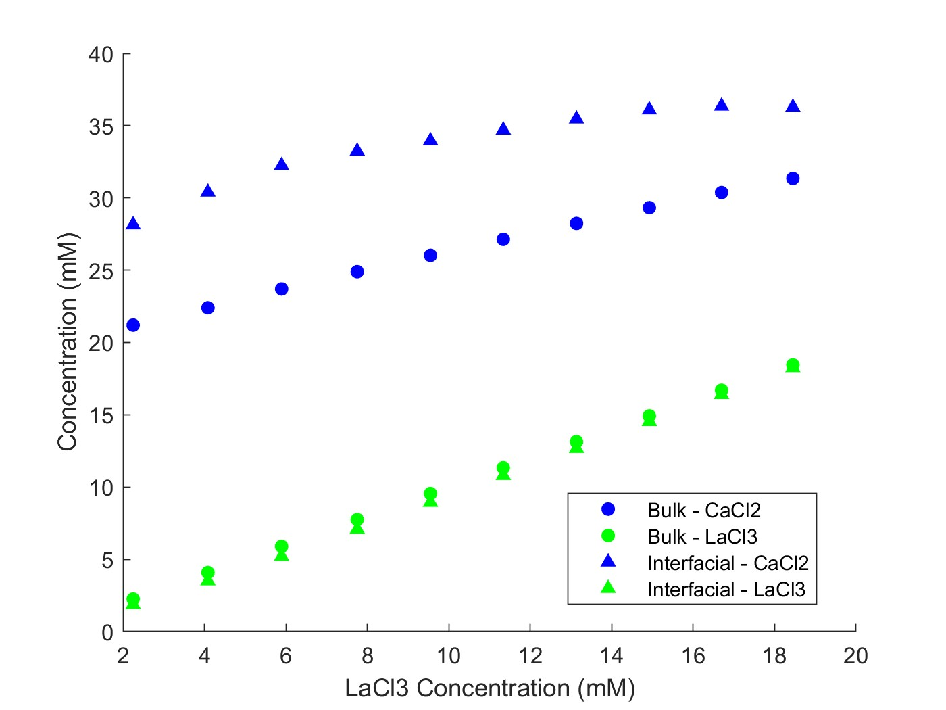
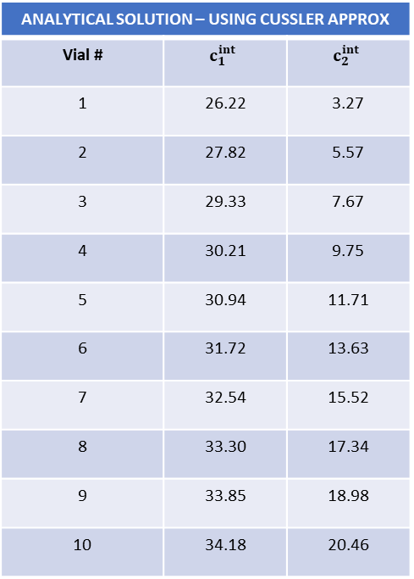
NF270_MC5, 09.08.25_E9
Multicomponent: CaCl2, LaCl3
Feed: 20 mM CaCl2
Diafiltrate: 12 mM CaCl2; 15 mM LaCl3
ANALYTICAL SOLUTION – USING CUSSLER APPROX
Vial # | $$c_{1}^{int}$$ | $$c_{2}^{int}$$
1 | 26.22 | 3.27
2 | 27.82 | 5.57
3 | 29.33 | 7.67
4 | 30.21 | 9.75
5 | 30.94 | 11.71
6 | 31.72 | 13.63
7 | 32.54 | 15.52
8 | 33.30 | 17.34
9 | 33.85 | 18.98
10 | 34.18 | 20.46

Slide 13
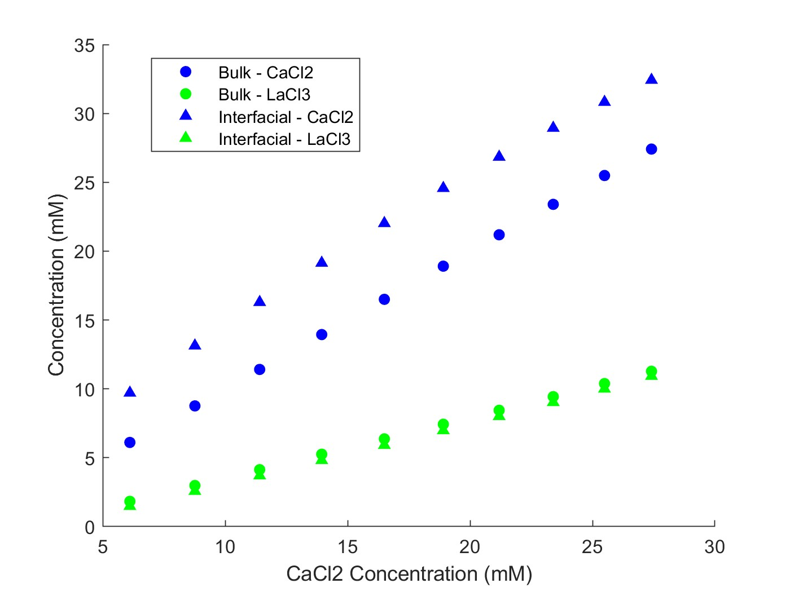
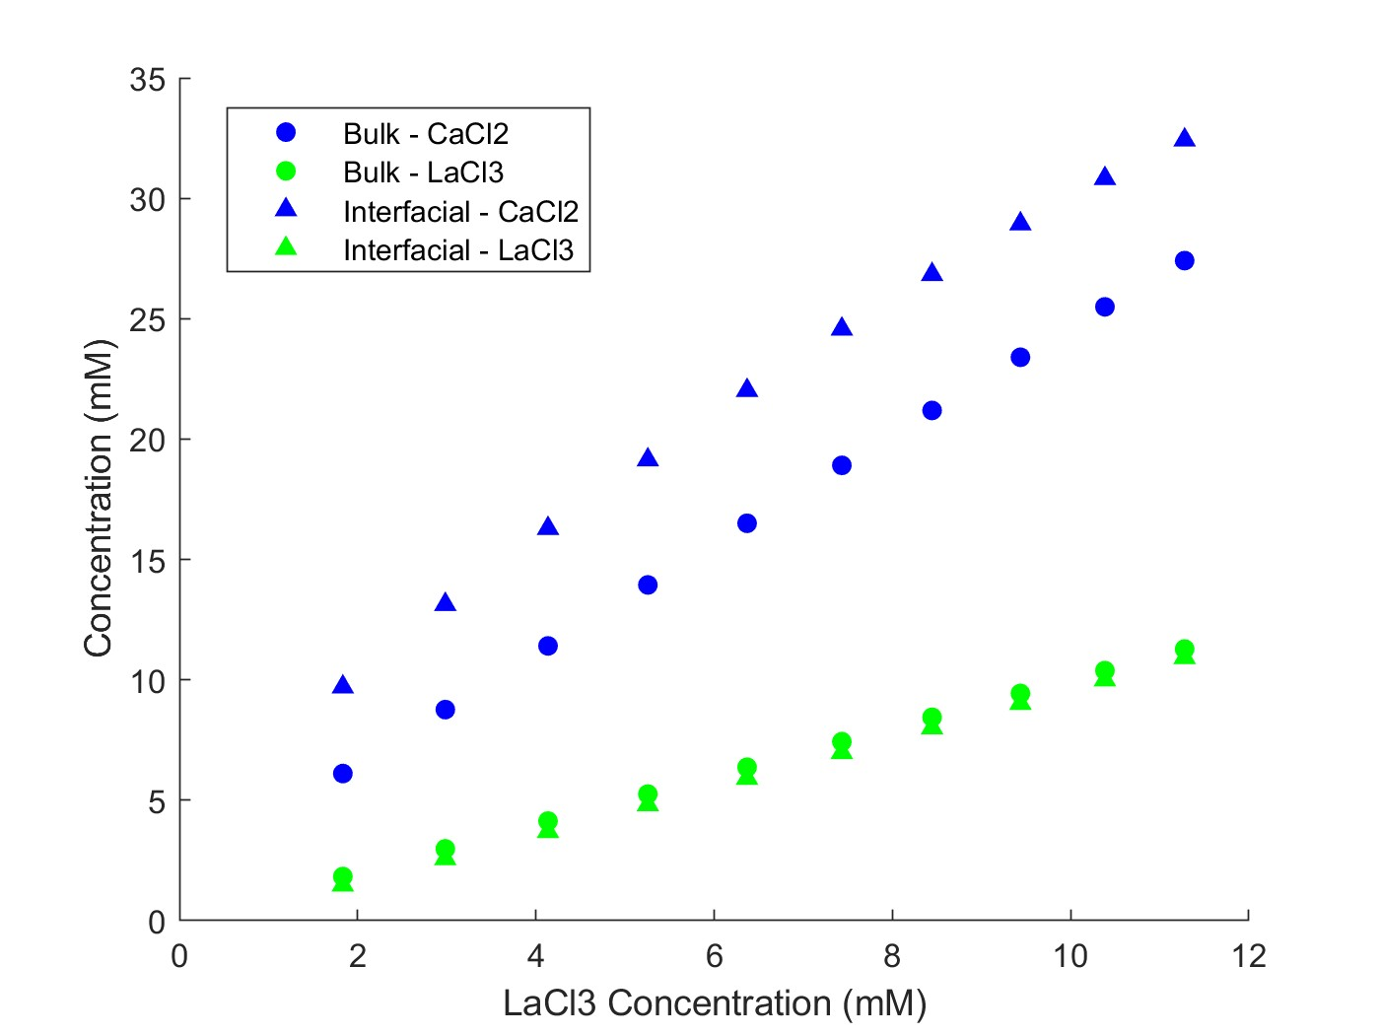
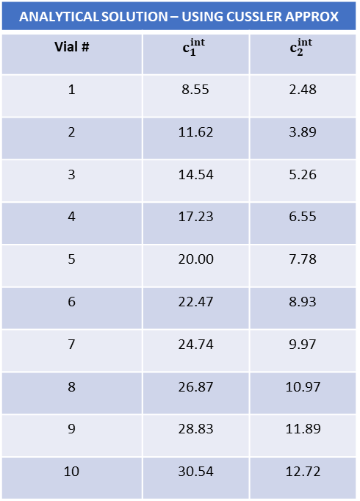
NF270_MC2, 05.22.24_E10
Multicomponent: CaCl2, LaCl3
Feed: 1 mM LaCl3; 5 mM CaCl2
Diafiltrate: 10 mM LaCl3; 25 mM CaCl2
ANALYTICAL SOLUTION – USING CUSSLER APPROX
Vial # | $$c_{1}^{int}$$ | $$c_{2}^{int}$$
1 | 8.55 | 2.48
2 | 11.62 | 3.89
3 | 14.54 | 5.26
4 | 17.23 | 6.55
5 | 20.00 | 7.78
6 | 22.47 | 8.93
7 | 24.74 | 9.97
8 | 26.87 | 10.97
9 | 28.83 | 11.89
10 | 30.54 | 12.72

Slide 14
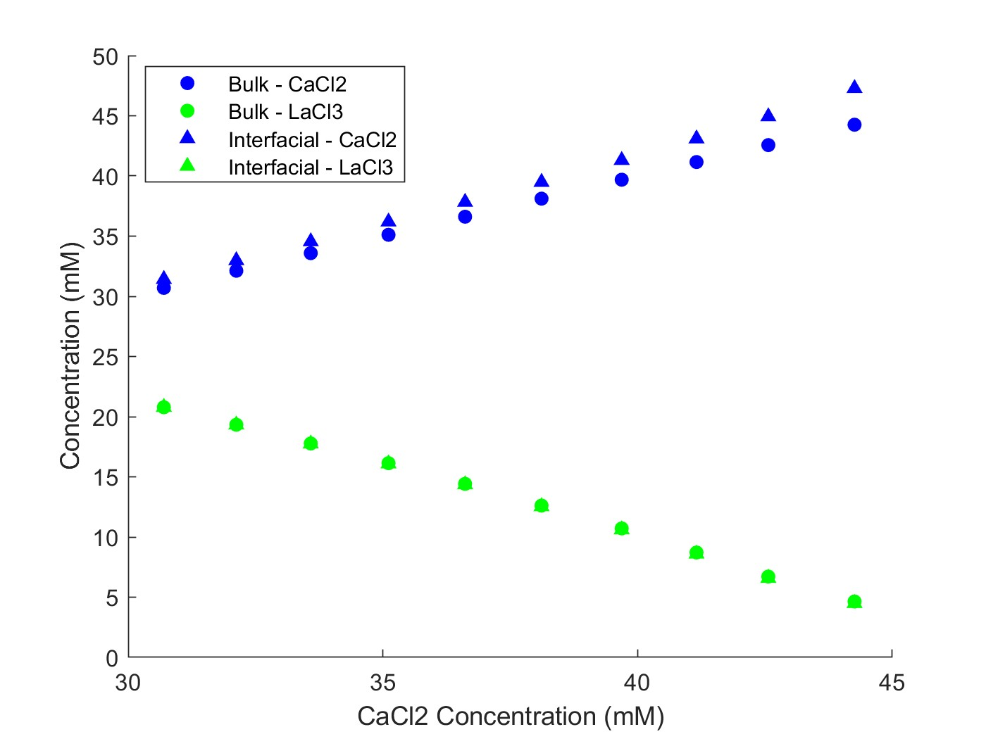
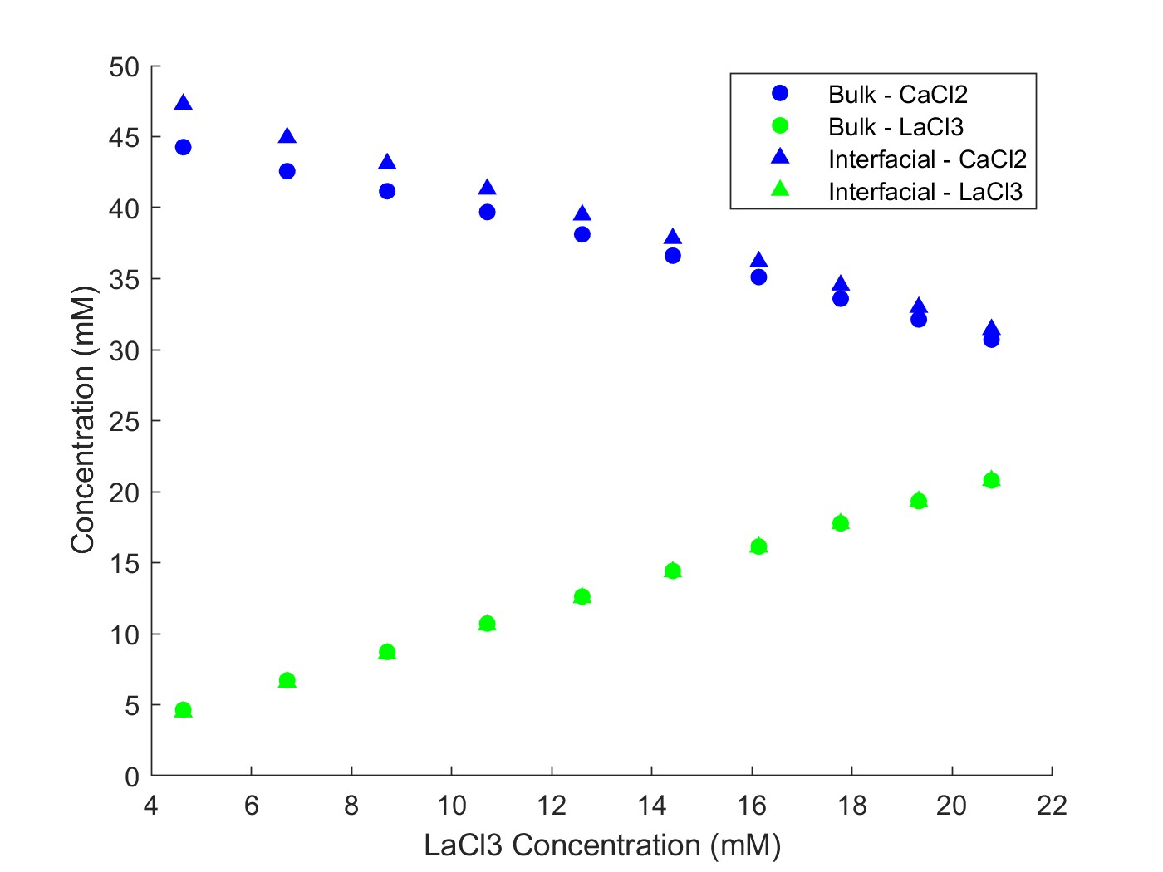
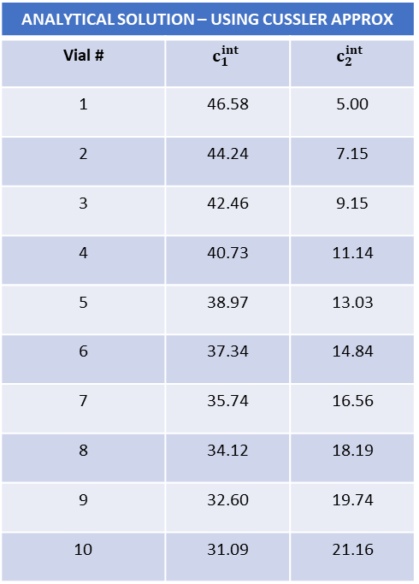
Multicomponent: CaCl2, LaCl3
Feed: 50 mM CaCl2; 1 mM LaCl3
Diafiltrate: 20 mM LaCl3
NF270_MC4, 07.16.24_E17
ANALYTICAL SOLUTION – USING CUSSLER APPROX
Vial # | $$c_{1}^{int}$$ | $$c_{2}^{int}$$
1 | 46.58 | 5.00
2 | 44.24 | 7.15
3 | 42.46 | 9.15
4 | 40.73 | 11.14
5 | 38.97 | 13.03
6 | 37.34 | 14.84
7 | 35.74 | 16.56
8 | 34.12 | 18.19
9 | 32.60 | 19.74
10 | 31.09 | 21.16

Slide 15
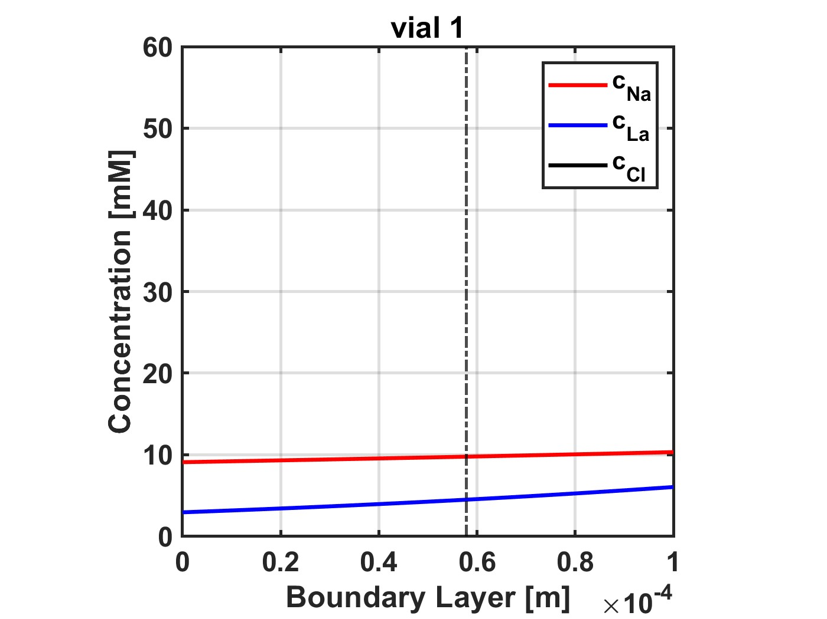
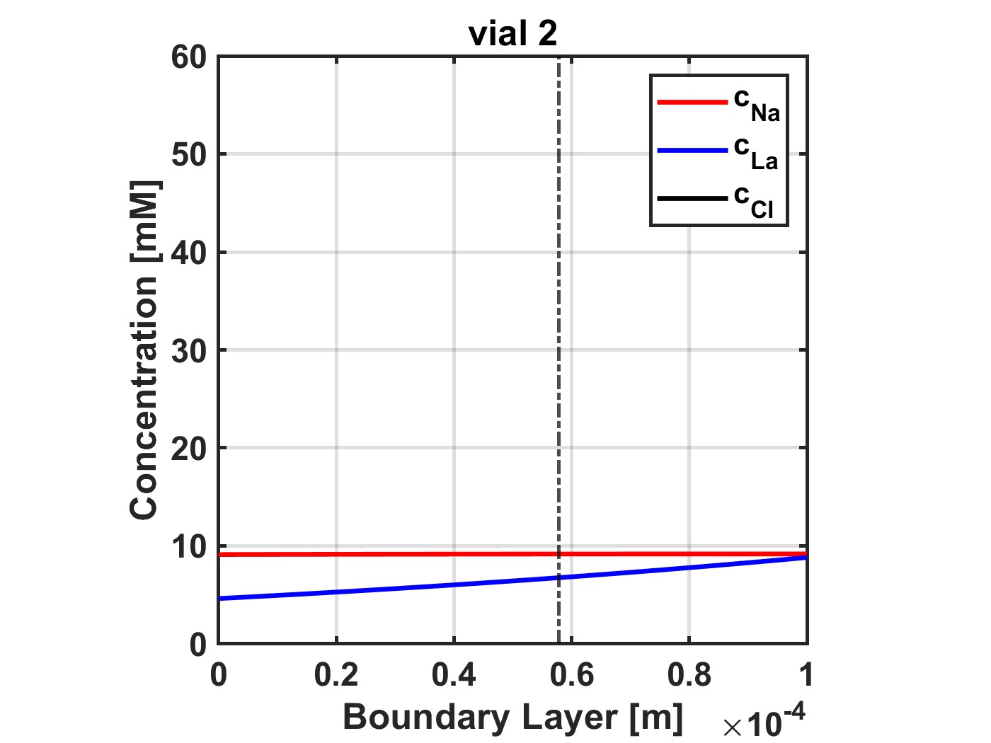
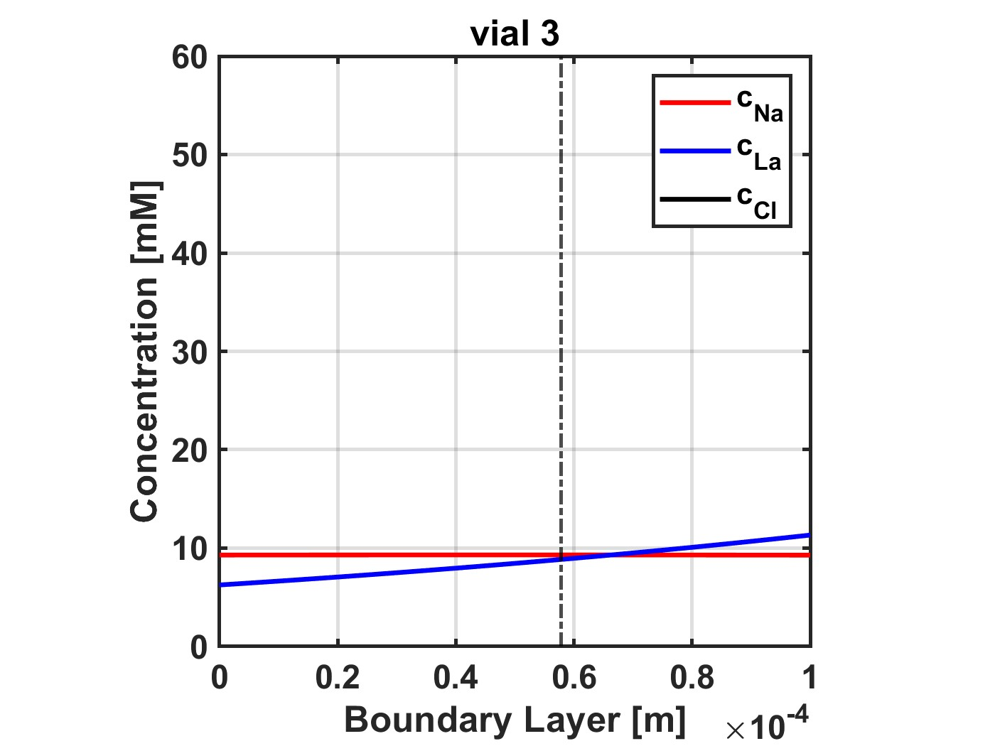
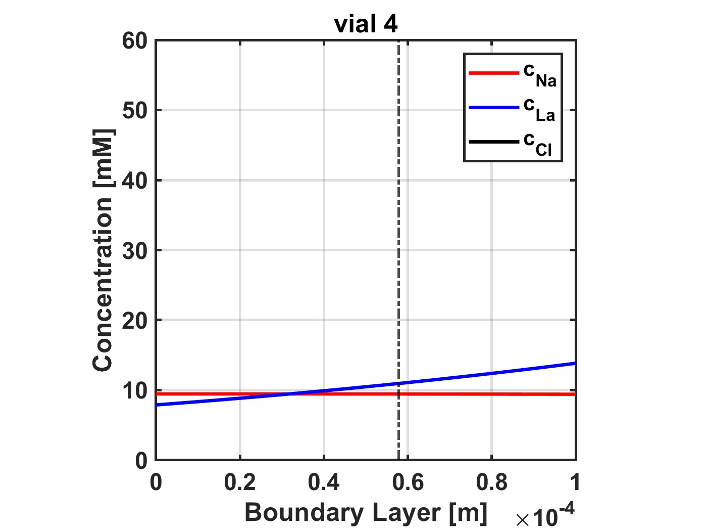









Multicomponent: NaCl, LaCl3
Feed: 10 mM NaCl
Diafiltrate: 5 mM NaCl; 15 mM LaCl3
NF270_MC2, 05.28.24_E11
NUMERICAL SOLUTION – USING ODE15
Vial # | $$c_{1}^{int}$$ | $$c_{2}^{int}$$
1 | 9.77 | 4.51
2 | 9.17 | 6.76
3 | 9.31 | 8.85
4 | 9.45 | 10.96
5 | 9.61 | 12.99
6 | 9.82 | 14.94
7 | 9.98 | 16.78
8 | 10.17 | 18.56
9 | 10.30 | 20.21
10 | 10.42 | 21.78
ANALYTICAL SOLUTION – USING CUSSLER APPROX
Vial # | $$c_{1}^{int}$$ | $$c_{2}^{int}$$
1 | 9.62 | 4.59
2 | 9.00 | 6.86
3 | 9.14 | 8.95
4 | 9.29 | 11.05
5 | 9.44 | 13.08
6 | 9.66 | 15.04
7 | 9.84 | 16.87
8 | 10.04 | 18.60
9 | 10.18 | 20.24
10 | 10.31 | 21.82

Slide 16


Multicomponent: NaCl, LaCl3
Feed: 20 mM NaCl
Diafiltrate: 10 mM NaCl; 15 mM LaCl3
NF270_MC2, 05.28.24_E12
ANALYTICAL SOLUTION – USING CUSSLER APPROX
Vial # | $$c_{1}^{int}$$ | $$c_{2}^{int}$$
1 | 21.14 | 4.79
2 | 18.68 | 6.78
3 | 18.28 | 8.59
4 | 18.17 | 10.46
5 | 18.04 | 12.26
6 | 17.95 | 14.22
7 | 18.04 | 16.02
8 | 17.73 | 17.91
9 | 17.69 | 19.57
10 | 17.48 | 20.63

Slide 17


NF270_MC4, 07.12.24_E13
Multicomponent: NaCl, LaCl3
Feed: 5 mM LaCl3
Diafiltrate: 0.2 mM LaCl3; 50 mM NaCl
ANALYTICAL SOLUTION – USING CUSSLER APPROX
Vial # | $$c_{1}^{int}$$ | $$c_{2}^{int}$$
1 | 5.29 | 8.30
2 | 10.73 | 8.19
3 | 14.64 | 8.16
4 | 18.51 | 8.16
5 | 22.08 | 8.20
6 | 25.35 | 8.22
7 | 28.41 | 8.19
8 | 31.28 | 8.11
9 | 33.52 | 8.05
10 | 35.23 | 8.12

Slide 18


NF270_MC5, 09.09.25_E14
Multicomponent: NaCl, LaCl3
Feed: 10 mM LaCl3
Diafiltrate: 0.4 mM LaCl3; 50 mM NaCl
ANALYTICAL SOLUTION – USING CUSSLER APPROX
Vial # | $$c_{1}^{int}$$ | $$c_{2}^{int}$$
1 | 1.41 | 18.99
2 | 8.43 | 18.53
3 | 13.35 | 18.19
4 | 17.28 | 18.04
5 | 21.14 | 18.06
6 | 24.37 | 18.12
7 | 27.38 | 18.01
8 | 29.95 | 17.73
9 | 32.08 | 17.34
10 | 32.97 | 17.41

Slide 19



Multicomponent: NaCl, LaCl3
Feed: 10 mM NaCl; 1 mM LaCl3
Diafiltrate: 50 mM NaCl; 10 mM LaCl3
NF270_MC2, 05.30.24_E15
ANALYTICAL SOLUTION – USING CUSSLER APPROX
Vial # | $$c_{1}^{int}$$ | $$c_{2}^{int}$$
1 | 12.43 | 2.90
2 | 16.59 | 4.60
3 | 20.41 | 6.28
4 | 23.58 | 7.84
5 | 26.56 | 9.22
6 | 29.24 | 10.40
7 | 31.77 | 11.57
8 | 33.46 | 12.99
9 | 34.84 | 14.47
10 | 36.45 | 14.56

Slide 20



NF270_MC4, 07.16.24_E16
Multicomponent: NaCl, LaCl3
Feed: 50 mM NaCl; 1 mM LaCl3
Diafiltrate: 10 mM NaCl; 20 mM LaCl3
ANALYTICAL SOLUTION – USING CUSSLER APPROX
Vial # | $$c_{1}^{int}$$ | $$c_{2}^{int}$$
1 | 60.22 | 4.50
2 | 48.13 | 8.37
3 | 44.50 | 11.63
4 | 42.07 | 14.55
5 | 39.82 | 17.24
6 | 37.42 | 19.83
7 | 35.52 | 22.32
8 | 33.67 | 24.66
9 | 32.04 | 26.87
10 | 30.49 | 29.06

